Slide 1
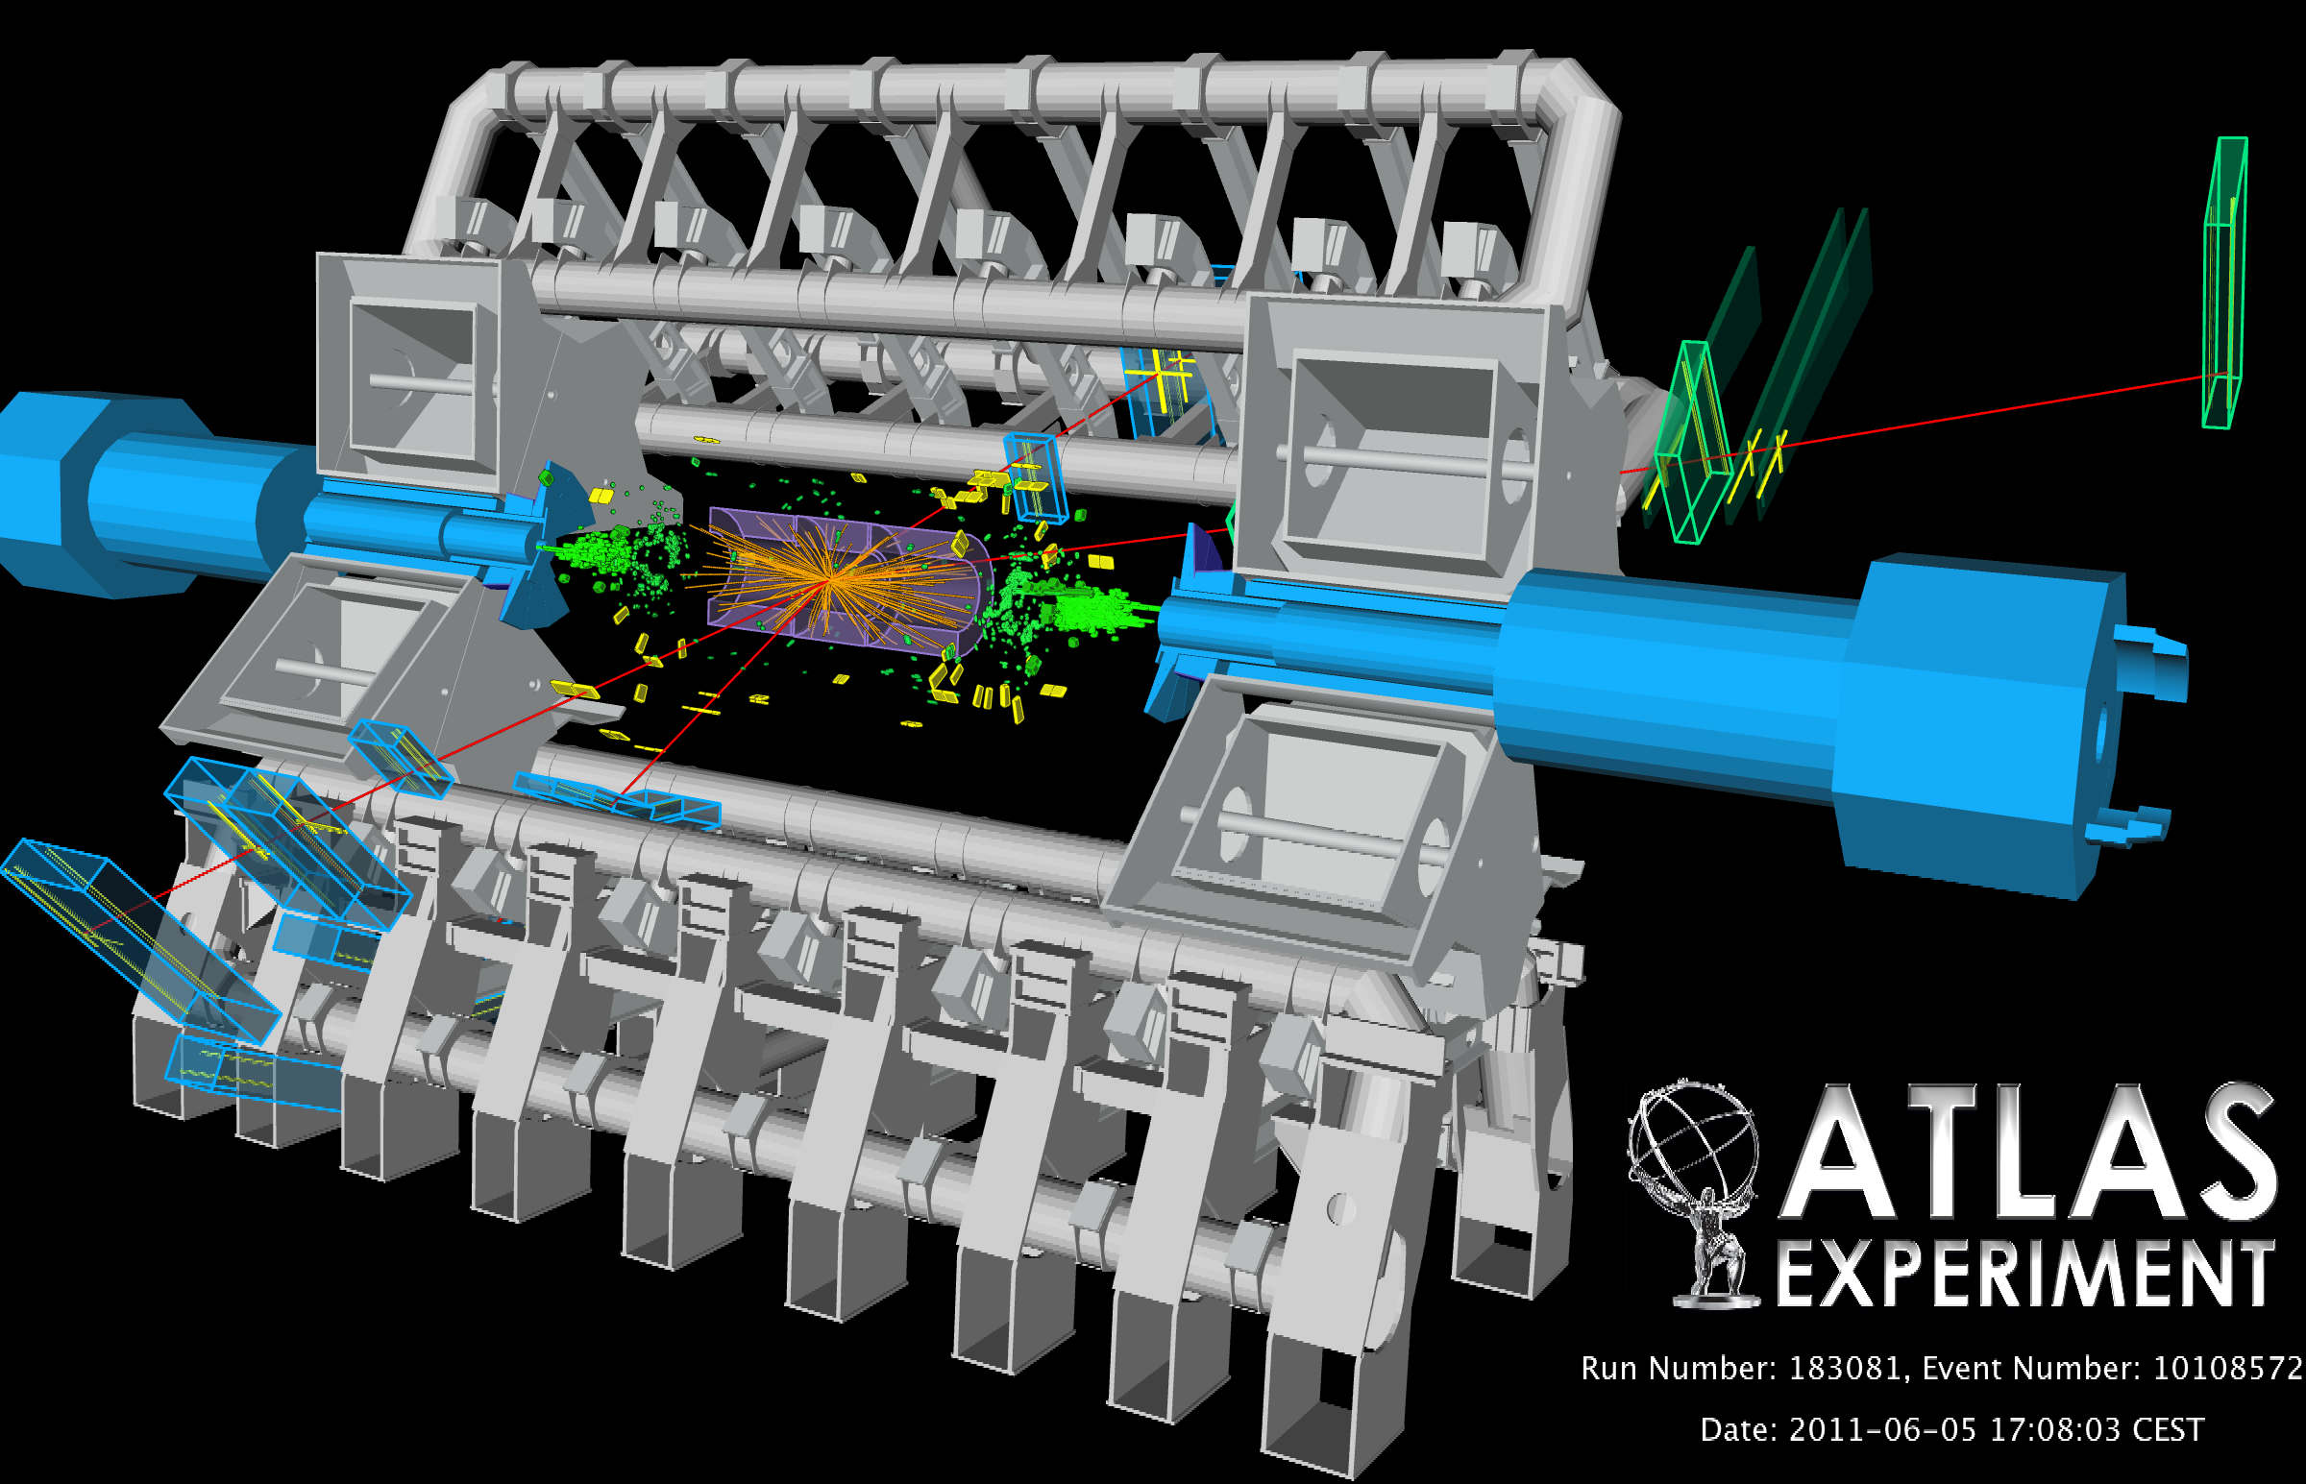
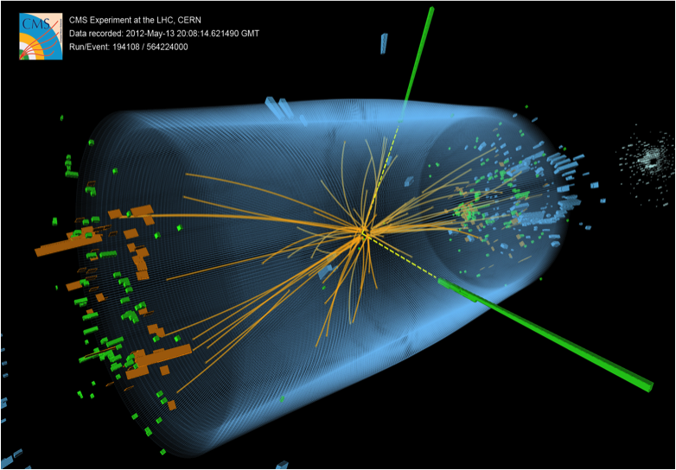


Higgshlights from the LHC: Searching for anosmalies
Tony Doyle

Slide 2

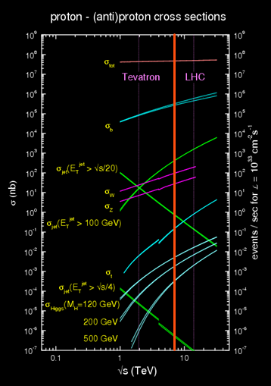

Outline
Experiment: Status
Standard Model Candles:
W/Z bosons, top production
Beyond the Standard Model:
Exotics, SUSY
Theory: Higgs and everything else..
Higgs Voyage of Discovery
Selected Newsworthy Higgshlights
“Do you see over yonder, friend Sancho,
thirty or forty hulking giants?
I intend to do battle with them and slay them.”
― Miguel de Cervantes Saavedra, Don Quixote
10 orders of magnitude
?

Slide 3
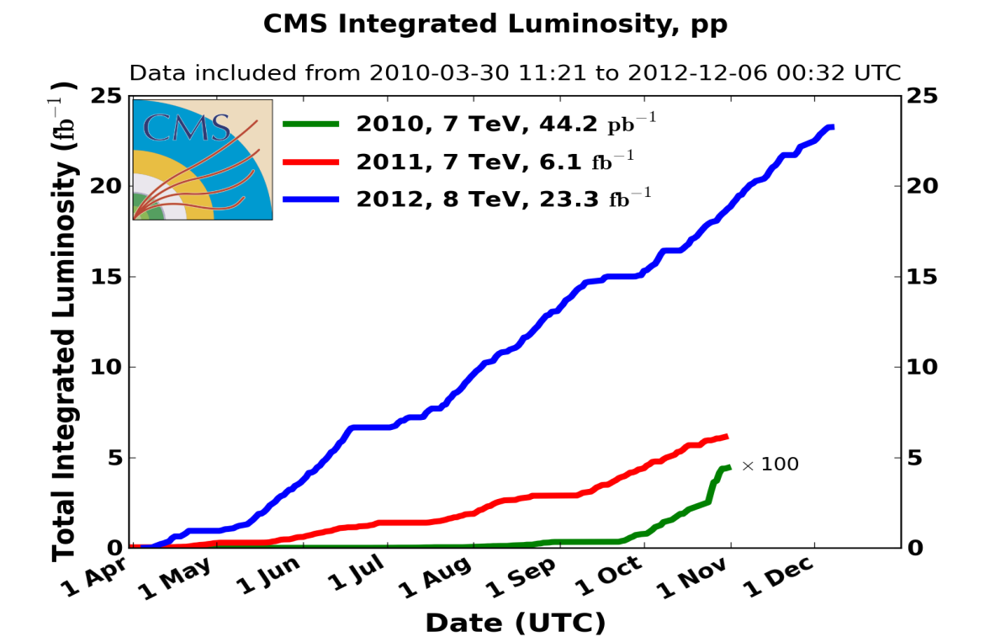
LHC Machine
High luminosity
Higher energy (8 TeV) -> ~10% Larger significance (S/√B): discovery ingredient
q
→ LHC Motivation
Z⁰
q₁
W
W
H
q₂
p
p
Z⁰
q

Slide 4
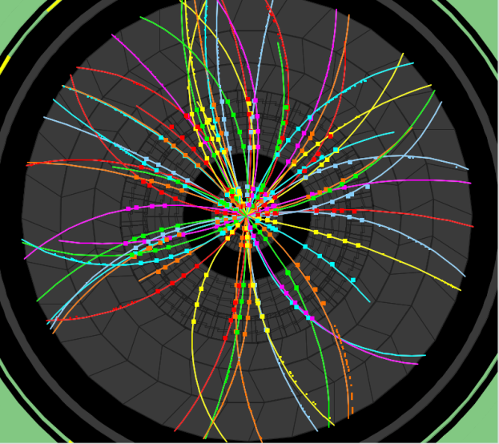
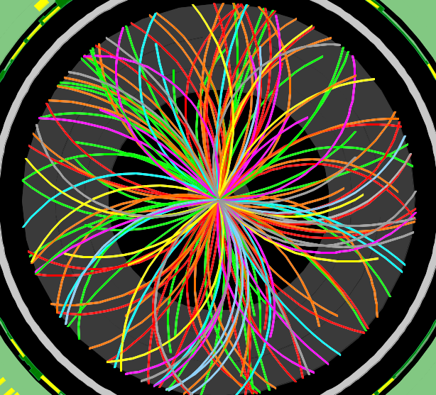
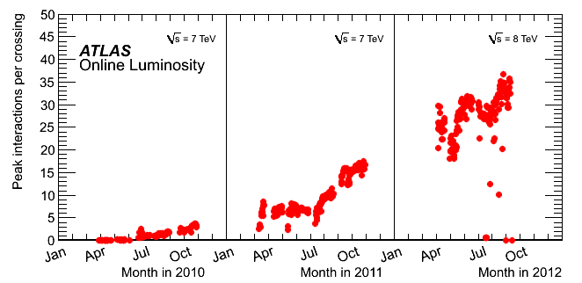
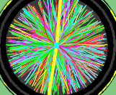
Three Years of Remarkable LHC operations at the Energy frontier
2010
2011
O(2) Pile-up events
2012:
23 fb⁻¹
at 8 TeV
150 ns inter-bunch spacing
Event taken at random (filled) bunch crossings
4th July seminar
and ICHEP
2011
5.6 fb⁻¹
at 7 TeV
2010
0.05 fb⁻¹
at 7 TeV
2011
O(10) Pile-up events
Event taken at random (filled) bunch crossings
50 ns inter-bunch spacing
Design value
(expected to be
reached at L=10³⁴ !)
2012
O(20) Pile-up events
50 ns inter-bunch spacing

Slide 5
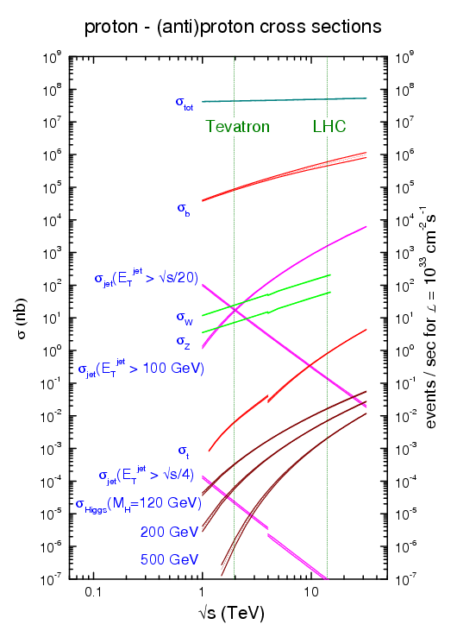
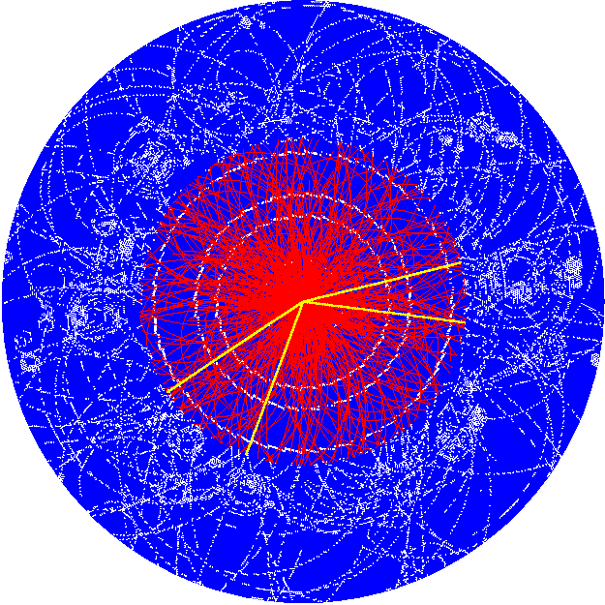
a. Rare Phenomena
Huge Background
Higgs Challenge
b. Complexity
All interactions
10 orders of magnitude
The Higgs
  “one in 10 billion events”
  “90 million readout channels”

Slide 6
Pileup in 2012
In general, do not expect a significant impact on tracking, nor muons, nor even electrons and photons
However, sizable impact on jets, E_{T}^{miss} and tau reconstruction as well as on trigger rates and computing
Z → μμ event in ATLAS with 25 reconstructed vertices
Display with track p_{T} threshold of 0.4 GeV and all tracks are required to have at least 3 Pixel and 6 SCT hits
→ LHC Motivation
q
Z⁰
q₁
W
W
H
q₂
p
p
Z⁰
q

Slide 7
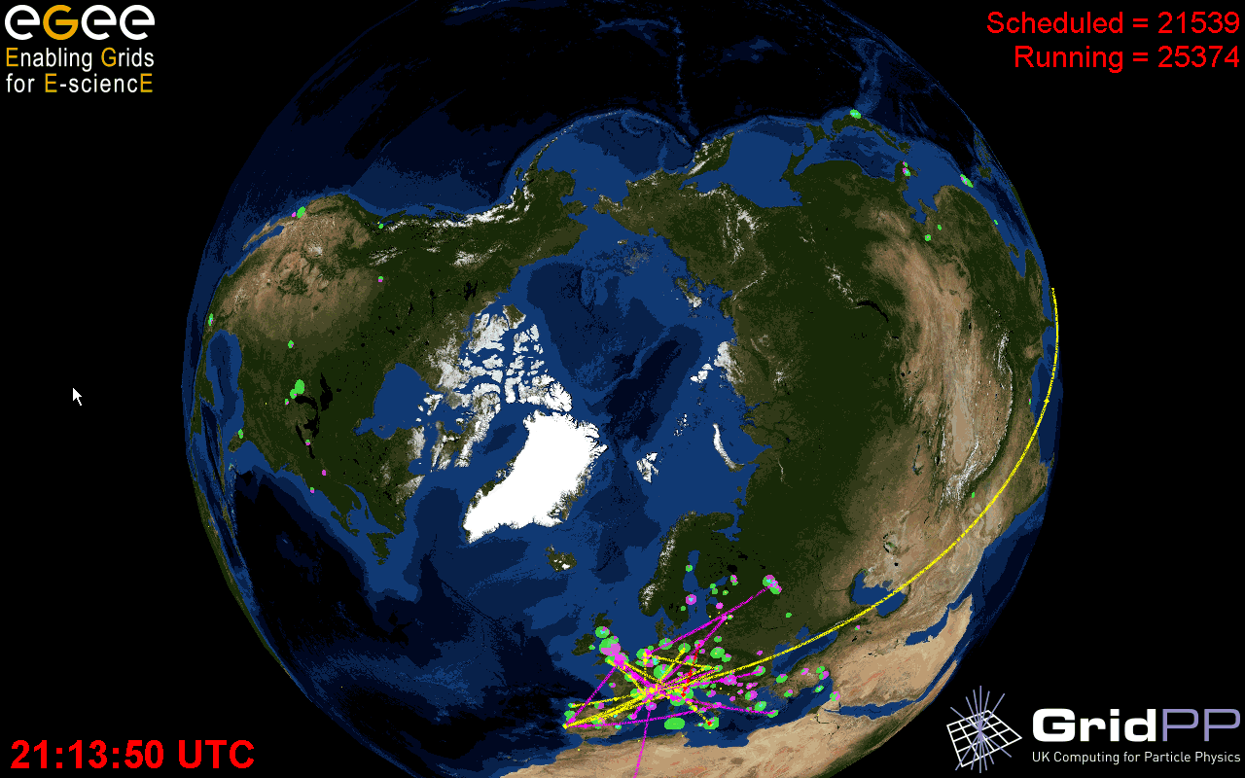
The Grid - Physics Delivery
Data preparation:
  First-pass reco. at Tier-0 within ~2 days
  Calibration/DQ good for physics analysis
  Data analysable on Grid within ~1 week
Tier-1 and Tier-2's process ~ 2M jobs per week
  simulation
  re-reconstruction (campaigns)
  group production (ntuples...)
  physics analysis
The high quality computing system allows us to show results on data taken until the end of the run
January
Now e.g. 120 PB of data for ATLAS alone

Slide 8


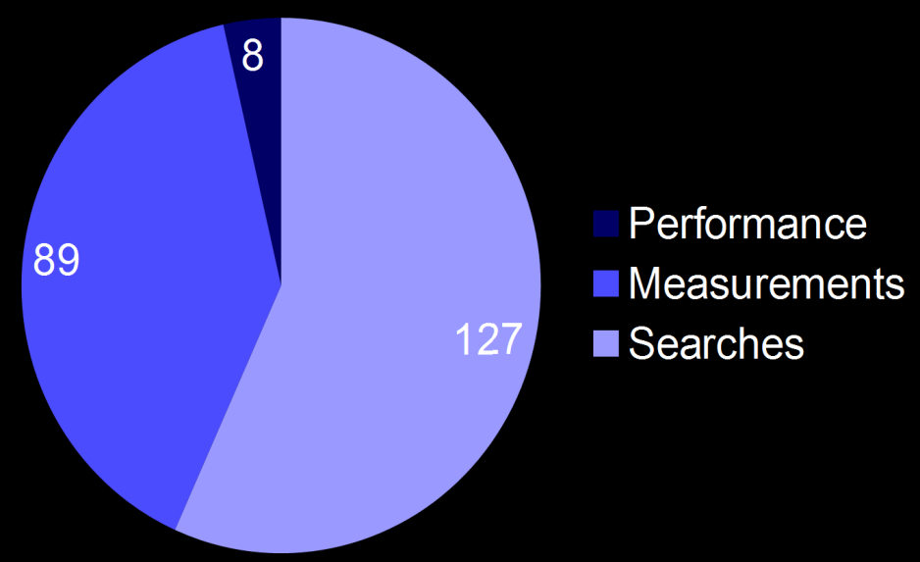
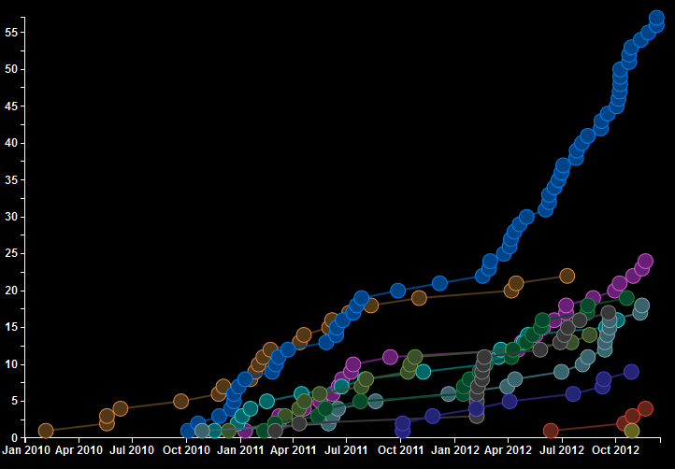
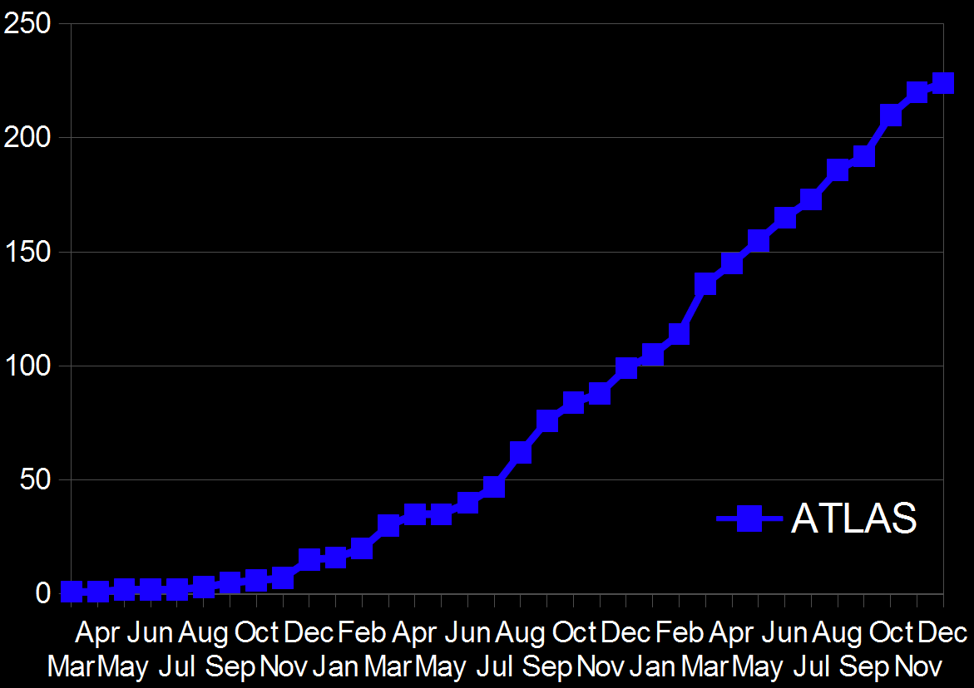

(17/12/12)
Publications
+
3 years of physics delivery
224+200=424 submitted papers

Slide 9
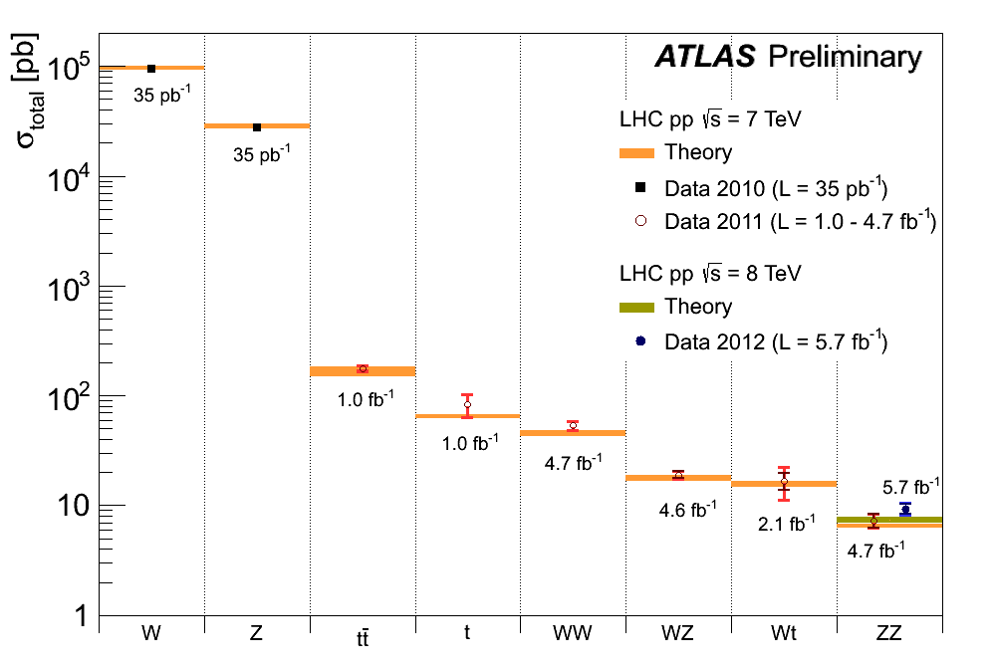

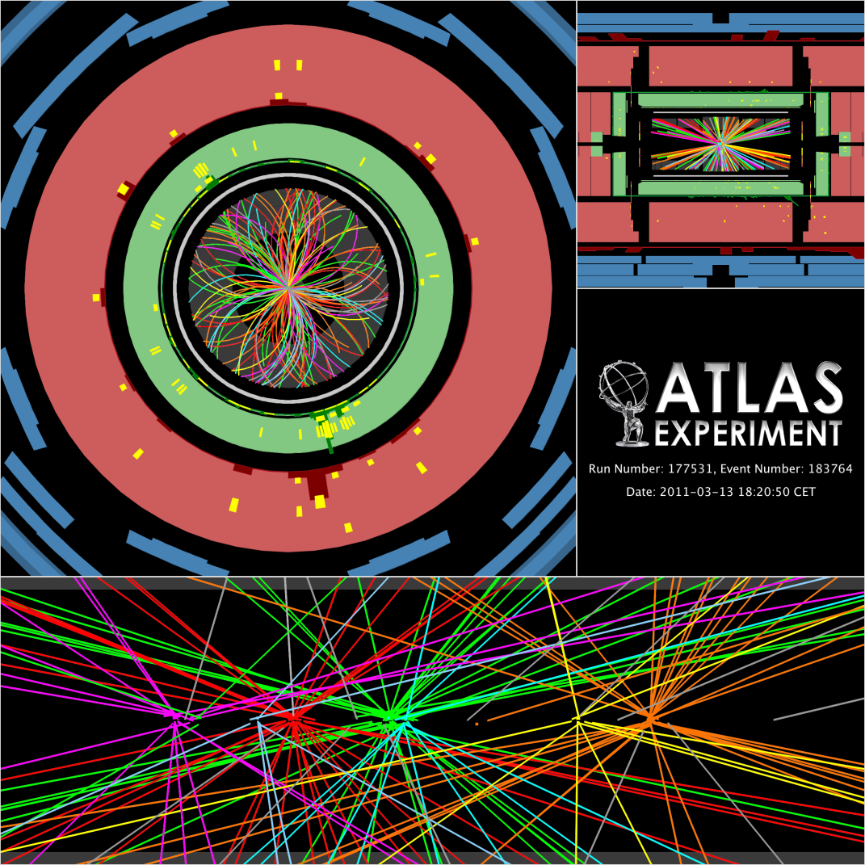
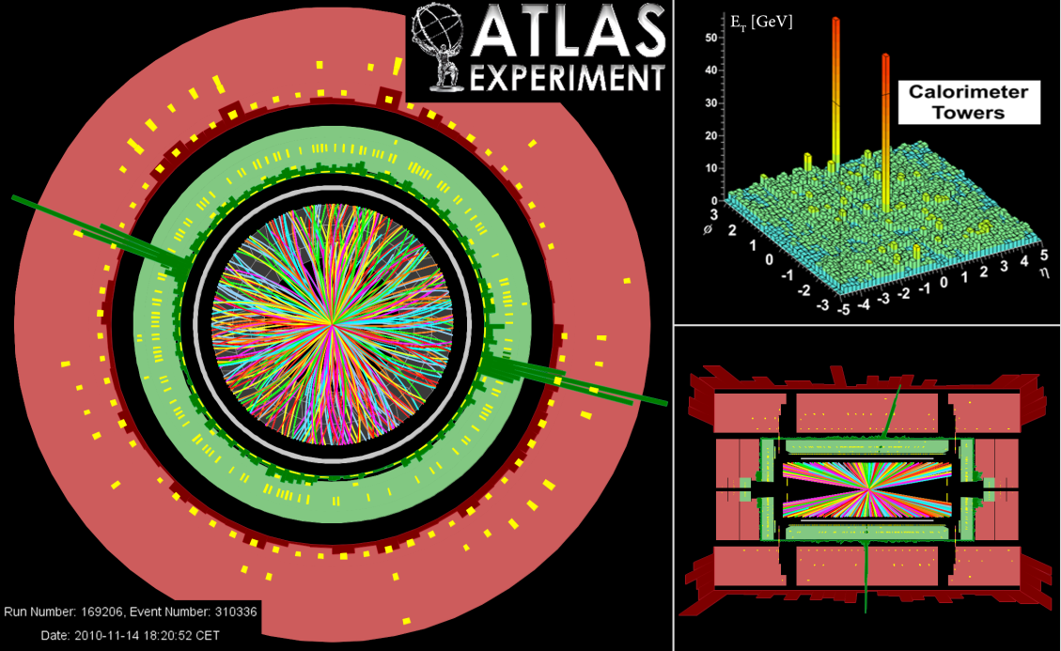
Overview of electroweak and top processes
Theory and simulation “Next-to…” revolution :
NNLO PDFs sets
Calculations at unprecedented order in perturbation theory
Parton Shower (and Matrix Element matching) improvements
Number of events selected in full 2010-12 dataset
W → lν ~ 100 M
Z→ ll ~ 10 M
tt → l+X ~ 0.4 M (top factory)
No PU

Slide 10
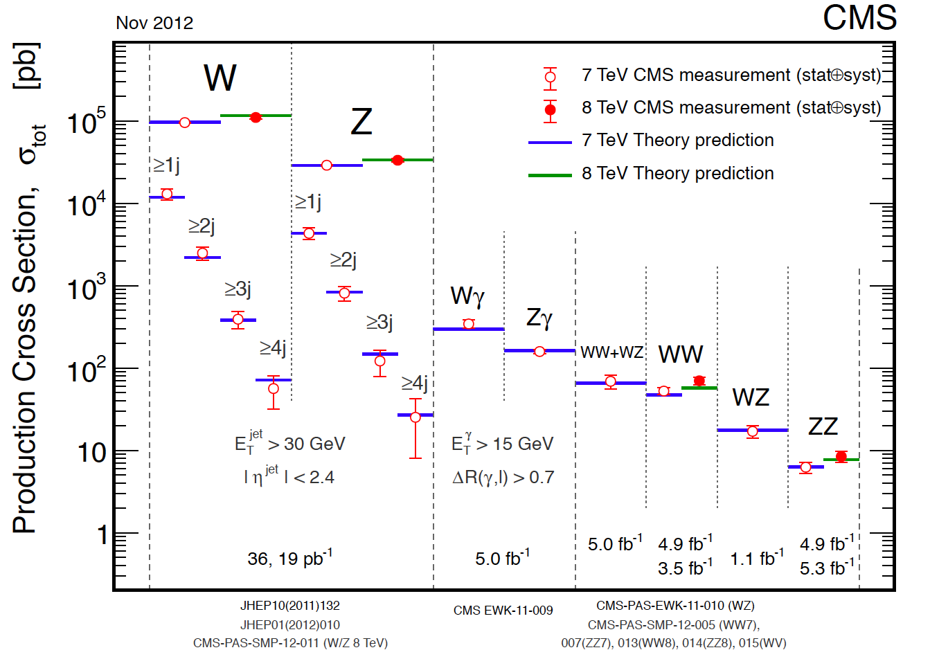
Electroweak Highlights
SMP-12-013
SMP-12-014
W, Z, WW and ZZ cross sections at 8 TeV
(Special Low pile-up runs used for W,Z at 8 TeV)
SMP-12-011
Measured σ (ZZ) = 8.4 ± 1.3 pb
SM (NLO) σ (ZZ) = 7.7 ± 0.4 pb
Measured σ (WW) =69.9 ± 7.0 pb
SM (NLO) σ (WW) = 57.3 ± 2.0 pb
σ(pp → Wx) x Br(W → l ν) = 11.88 ± 0.56 nb
σ(pp → Zx) x Br(Z → l⁺ l⁻) = 1.12 ± 0.05 nb
Predicted increase of the cross sections with energy is confirmed by measurements
8 TeV
Excellent understanding of the Standard Model at 7,8 TeV…
Notes:
W,Z,WW,WZ,ZZ
W, Z are very heavy and very important
From the Brout-Englert-Higgs mechanism!
They appear singly or in pairs in the decays of particles predicted in new physics models
We must understand how they are produced in the Standard Model (SM) before we can look for things beyond the Standard Model
Observation of processes involving a virtual Z decaying to Z+Z or Z+γ would be a spectacular indication of new physics.
SMP-12-011
We use a data sample collected in 2012 corresponding to an integrated luminosity of 18.7pb-1.
The LHC instantaneous luminosity increased dramatically compared to the dataset used for the first measurements, from 2x10^31 to 7 10^33 cm-2s-1, and the average number of inelastic proton-proton interactions (pileup) moved from two up to twenty. In order to perform a precision measurement of the inclusive W and Z boson cross sections at sqrt s = 8 TeV, a dedicated LHC configuration was deployed to accumulate a dataset with
low pileup and low transverse momentum trigger thresholds.
Theoretical predictions of the inclusive W and Z cross sections are available at next-to-next-to leadingorder (NNLO) in perturbative QCD. The calculations are limited by uncertainties on
parton distribution functions (PDFs), higher-order QCD, and EWK radiative corrections, which are available at next-to-leading order (NLO)
Figure 10 shows the W and Z boson production cross section measurements at sqrt s=8 TeV together with the earlier CMS measurements at sqrt s =7 TeV and with measurements at lower
center-of-mass energy hadron colliders. The predicted increase of the cross sections with center of mass energy is confirmed by our measurements. These measurements are consistent between the electron and muon
channels, and in agreement with next-to-next-to-leading order cross section calculations.
σ(pp → WX) X B(W → l ν) = 11.88 ± 0.03 (stat.) ± 0.22 (syst.) ± 0.52 (lumi.) nb
σ(pp → ZX) X B(Z → l⁺ l⁻) = 1.12 ± 0.01 (stat.) ± 0.02 (syst.) ± 0.05 (lumi.) nb
Key ingredients for Higgs hunting:
σιγμα(pp) → Hx (mH=125GeV) 17.5pb same order of magnitude of the diboson (WW,WZ,ZZ) .
SMP-12-013
This document reports on a measurement of the W⁺W⁻ production cross section in pp collisions at sqrt(s) = 8TeV. The data were collected at the LHC with the CMS detector, and correspond to an integrated luminosity of 3.54 fb⁻¹.
The W⁺W⁻ candidates are selected in events with two charged leptons (electrons or muons) and large missing transverse energy. The W⁺W⁻ cross section is measured to be = 69.9 ± 2.8 (stat.) ± 5.6 (syst.) ± 3.1 (lumi.) pb.
The selection applied in this paper closely follows the selection applied in the search for the Higgs bosons. More precisely, the Higgs preselection for masses above 140 GeV and the selection applied in this paper differ only in the minimum transverse momentum required of the trailing lepton: 10 GeV in the Higgs analysis and 20 GeV in the WW cross section measurement. The result is obtained by counting the number of events in the signal region in data. Then, the WW yield is obtained by subtracting the estimated contributions of the various SM background processes. The signal efficiency averaged over all lepton flavors including taus is found to be (3.22 ± 0.22)%. The total background yield is 275.2 ± 14.9 (stat.) ± 31.2 (syst.) events and the total number of observed events is 1111. Considering the branching ratio of (0.1080 ± 0.0009) we find the WW production cross section in pp collision data at sqrt(s) = 8 TeV, to be 69.9 ± 2.8 (stat.) ± 5.6 (syst.) ± 3.1 (lumi.) pb.
The systematic uncertainty includes both the statistical and systematic uncertainties on the background prediction, as well as the uncertainty on the signal efficiency. This measurement is consistent with the SM expectation of 57.3 +2.4 -1.6 pb. The difference between the measured and the theoretical value is 12.6 ± 7.3 pb, equivalent to (22 ± 13)% of the theoretical value. (Experimental and theoretical uncertainties have been added in quadrature.)
The measurement of the WW cross section is interpreted in terms of a ratio to the Z production cross section, obtaining the following WW to Z cross section ratio, (2.09 ± 0.20) x 10⁻³ [± 6.4 (exp.) ± 5.0 (bkgd.) ± 3.1 (gen.) ± 4.1(stat.)]%.
SMP-12-014
A measurement of the ZZ production cross section in the ZZ to lll'l' decay mode with l = e, mu and l' = e, mu, or tau in proton proton collisions at $\sqrt{s} = 8\TeV$ with the CMS experiment at the LHC is presented. Results are based on data corresponding to an integrated luminosity of $5.26~\fbinv$. The measured cross section $\sigma ( pp \to ZZ) = 8.4 \pm 1.0(stat.) \pm 0.7 (sys.) \pm 0.4(lumi.)\, \rm{pb}$ is found to be consistent with the standard model predictions.

Slide 11
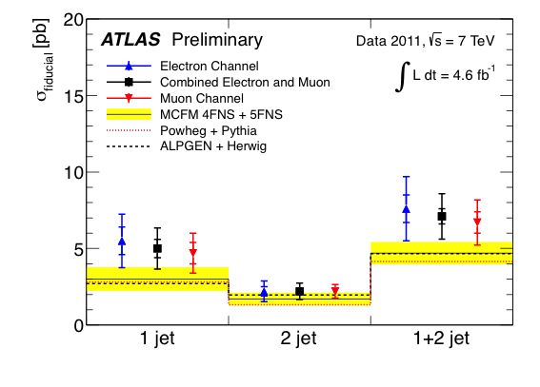
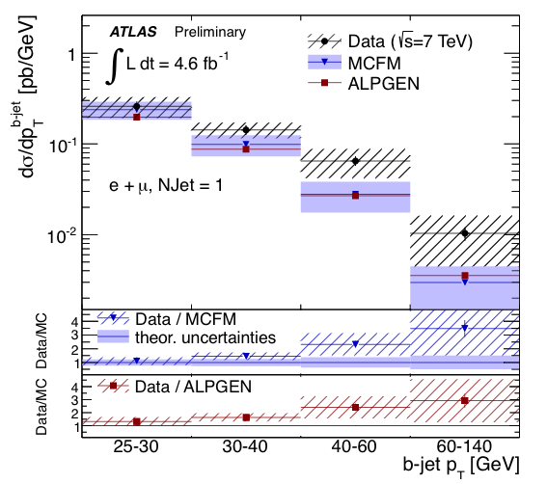
Electroweak highlights — differential x-sns
Large statistics allows precise tests of generators/theory, PDFs and bkgd to searches
ATLAS-CONF-2012-156
Measurement of W + b-jets fiducial (p_{T} > 25 GeV, |η| < 2.1) & differential cross section
Fiducial cross section within 1.5σ of theory prediction
p_{T} spectrum harder in data, but compatible within uncertainties with generators

Slide 12
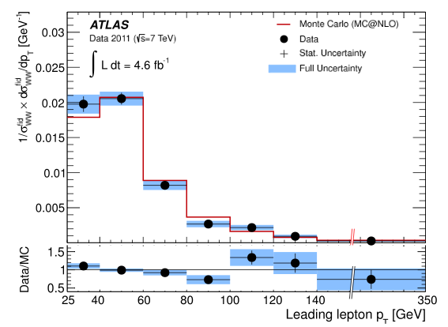
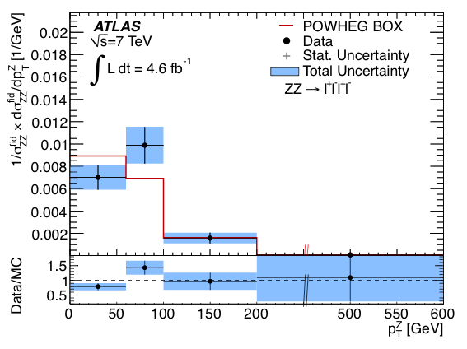
EW dibosons — WW, WZ, ZZ, Wγ, Zγ, γγ
Total, fiducial & differential diboson cross-sections measurements
Measured 11 diboson fiducial cross-sections: most are slightly above theory expectation (but sys. and theory errors correlated)
1210.2979, 1208.1390, 1211.6096
Examples for differential cross section measurements: WW, ZZ (7 TeV, 4.6 fb⁻¹)
Normalised fiducial differential cross-section (→ unfolded)
Normalised fiducial differential cross-section
Measured also llνν channel
Bin centres are cross-section weighted averages
So far, satisfying agreement with NLO generators, also for mass spectra. Same for WZ
Also searched for diboson resonance production (ZZ [8 TeV, ATLAS-CONF-2012-150], Wγ, Zγ)

Slide 13
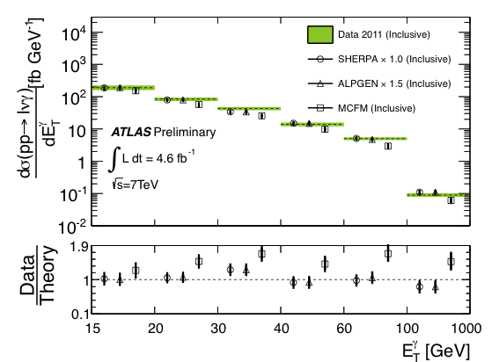
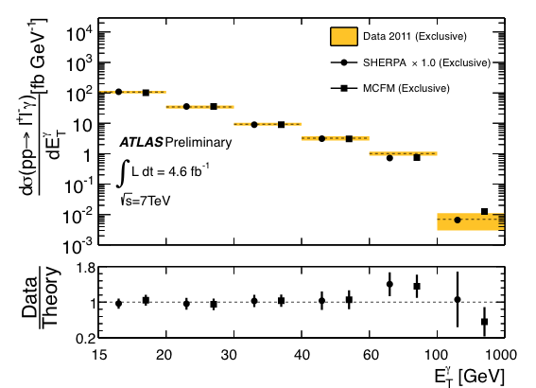
EW dibosons — WW, WZ, ZZ, Wγ, Zγ, γγ
Total, fiducial & differential diboson cross-sections measurements
Measured 11 diboson fiducial cross-sections: most are slightly above theory expectation (but syst. and theo. errors correlated)
Examples for differential cross section measurements: Wγ, Zγ (7 TeV, 4.6 fb⁻¹)
Inclusive E_{γ} fiducial differential cross-section
N-jet = 0 E_{γ} fiducial differential cross-section
Global scaling of SHERPA/ALPGEN to match data
Too low incl. cross-section by MCFM (NLO, parton-level). Scaled ALPGEN/SHERPA (LO) with multiple quark/gluon emission in ME more accurate → Similar for γγ [1211.1913]

Slide 14
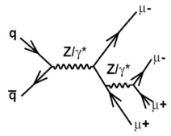
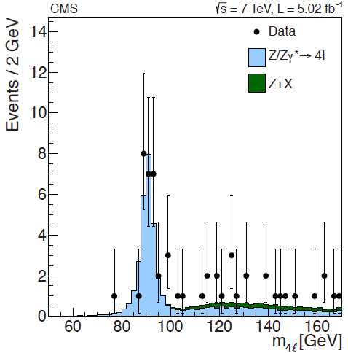
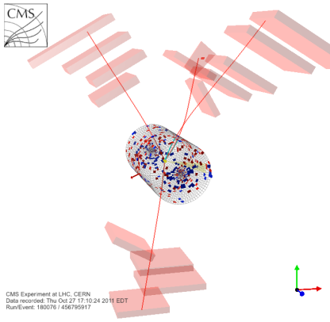
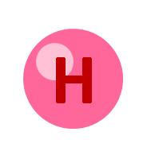
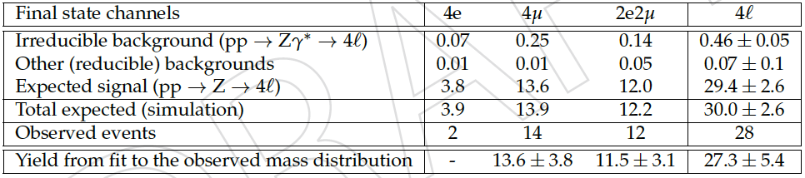
Electroweak Highlights
7 TeV
arXiv:1210.3844
SMP-12-009
Z−> 4l decay
9.7 σ observation
Cross-check of Higgs mass calibration
  Use Z−> 4l to understand the mass of 4 leptons for H −>ZZ−> 4l
  Gives up to 10x more events
  Low lepton p_{T} down to ~1 GeV
Notes:
SMP-12-009
Diagram of the Z->4l process for the irreducible background of Z->2l production with the initial-state radiation undergoing an internal conversion gamma*->2l. Both Z and gamma* are present in all propagators. The choice of propagators shown in the figures corresponds to the dominant contributions in the phase space 80 < m_{4l} < 100 GeV.
Four-lepton invariant mass distribution for events passing all selection requirements except that on m4l. The data are shown by points. The filled histograms represent standard model expectations for pp -> Z/Zgamma -> 4l and for reducible backgrounds. The three final states, 4e, 4mu, and 2e2mu, are combined.
Numbers of expected and observed events. The yields are determined by means of fits described in the text; the fit results in the 4e channel are not meaningful because only two events are selected.
Four-lepton mass distribution in simulation for pp->4l without the Higgs boson (light shaded histogram), Z + X background (dark shaded histogram), and pp->H->ZZ->4l for a Higgs boson mass mH = 125 GeV. The three contributions are stacked. The standard model cross section for the Higgs boson is scaled up by a factor of 5.
However, the observation of Z → 4l decays in pp collisions is of special interest. The clean resonant peak in the four-lepton invariant mass distribution at m4l = mZ can be used for direct calibration of the four-lepton
mass scale, the four-lepton mass resolution, and the overall four-lepton reconstruction efficiency in phase space similar to the light Higgs boson four-lepton decays, H → ZZ → 4l
The number of events with 80 < m4` < 100GeV is 28, in good agreement with the standard model expectation of 30.0 events. Table 2 shows good agreement between the expected and observed
events in each of the 4e, 4m, and 2e2m channels.
The Z → 4l decays give a narrow resonant peak in the four-lepton invariant mass distribution, which can be used as a calibration channel in the context of the Higgs boson search in the H →ZZ → 4l decay mode. Figure 3 (left) shows that the number of events in the Z→ 4l peak at m4l = mZ is approximately an order of magnitude larger than the expected number of events for the SM Higgs boson with a mass mH = 125 GeV
The Z → 4l peak can be used for a direct calibration of the four-lepton mass scale, the four-lepton mass resolution, and the overall four-lepton reconstruction efficiency in a phase space similar to the Higgs boson four
lepton decays. Such a direct calibration using the Z -> 4l peak is complementary to the current indirect tag-and-probe method making use of Z →2l events, with the benefit that Z → 4l has similar kinematics to H → ZZ → 4l.

Slide 15
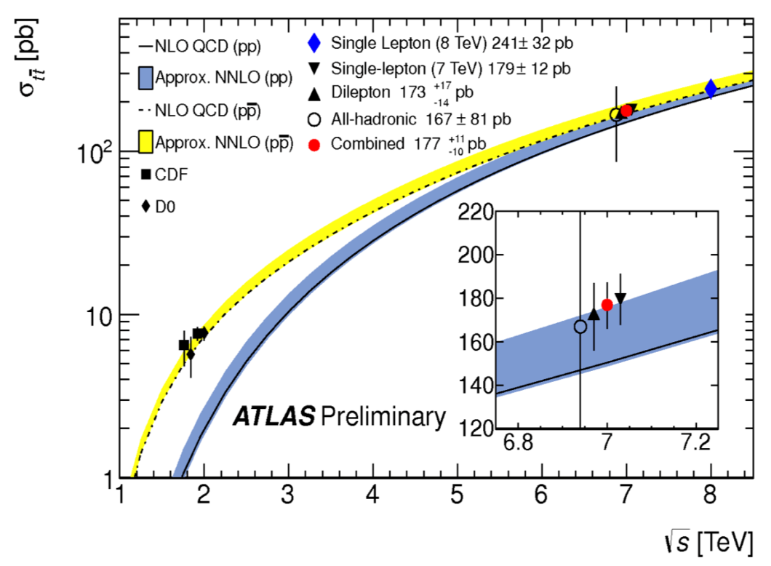
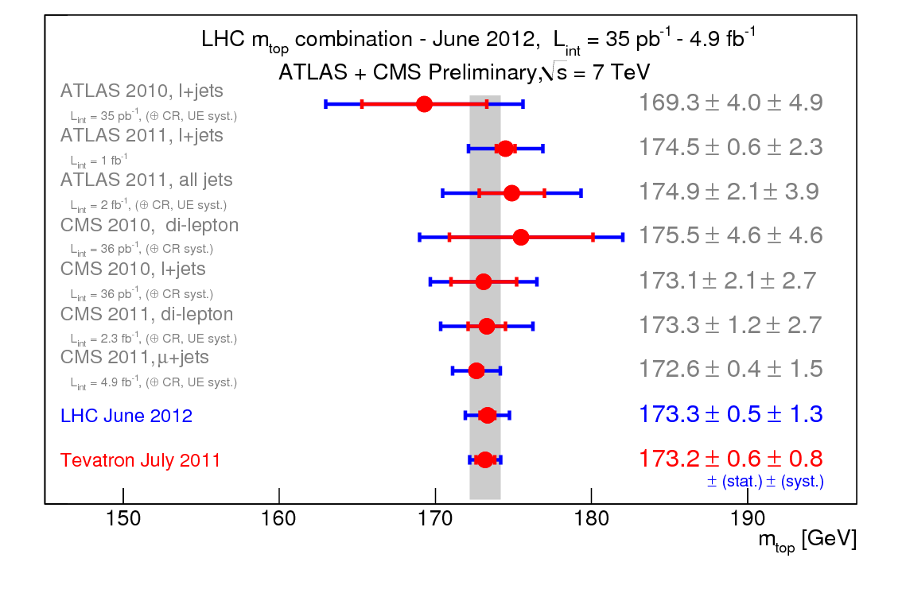
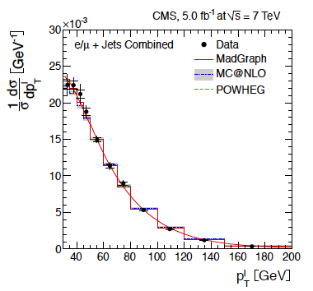
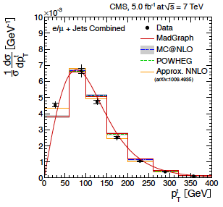
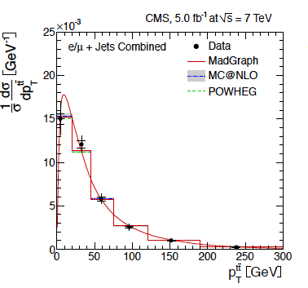
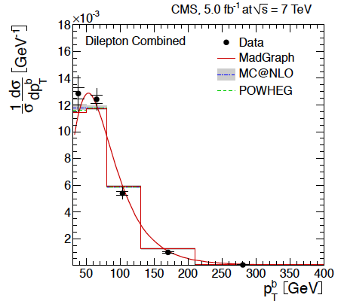
Top Highlights
arXiv:1211.2220
Differential σ_{tt} as function of the kinematic properties: good agreement Data vs MC
Notes:
TOP-11-018
TOP MASS: We present a combination of CMS top mass measurements in the lepton+jets, di- lepton and all-jets channels, using data recorded in 2010 and 2011 by the CMS ex-periment corresponding to an integrated luminosity of up to 5.0 fb−1. We present two combinations. The first uses three published results and gives a resulting top mass of 173.32 ± 0.27 (stat.) ± 1.02 (syst.) GeV. The second also includes the latest preliminary CMS measurements and yields an improved top-quark mass measurement of 173.36 ± 0.38 (stat.) ± 0.91 (syst.) GeV.
Top quark mass value is close to the scale of electroweak symmetry breaking (EWSB). Does it have a more fundamental role in EWSB?
Precise top mass measurements are crucial for accurate tests of the SM
The top sector is expected to be sensitive to new physics
top mass measurement with 5 fb-1 is in full agreement and the same precision as the Tevatron combination using 5.8/fb
TOP-12-018
The normalized differential ttbar cross section in jet multiplicity bins is presented, measured in proton-proton collisions using 5.0 fb⁻¹ of data collected at sqrt{s} = 7 TeV. The analysis is performed in the electron + jets and the muon + jets channels. The jet multiplicity distribution is particularly sensitive to extra jets radiation. A comparison of the data with different Monte Carlo generators is shown. After background subtraction, the data are in agreement with ttbar signal Monte Carlo distributions. Additionally, the measurement of the top quark pair differential cross-section in the number of radiated additional hard partons in the muon + jets channel is presented. The measured fractions of events with ttbar + 0, 1, and ≥ 2 additional partons are in good agreement with different Monte Carlo predictions.
In the figure
Normalized differential cross-section as a function of jet multiplicity for jets with p_{T} > 35 GeV. The data are compared with predictions from MADGRAPH+Pythia, MC@NLO+Herwig and POWHEG+Pythia. The errors on the data points indicate the statistical (inner bars) and the total uncertainty.
arXiv:1211.2220
Normalised differential top-quark pair production cross sections are measured in pp collisions at a centre-of-mass energy of 7 TeV at the LHC with the CMS detector using data recorded in 2011 corresponding to an integrated luminosity of 5.0 fb-1. The
measurements are performed in the lepton+jets decay channels (e+jets and mu+jets) and the dilepton decay channels (e+e-, mu+m-, and me). The tt differential cross section is measured as a function of kinematic properties of the final-state charged
leptons and jets associated to b quarks, as well as those of the top quarks and the tt system. The data are compared with several predictions from perturbative QCD calculations up to approximate next-to-next-to-leading-order precision. No significant
deviations from the standard model are observed.
arXiv:1211.3338
A search for resonances decaying to top quark-antiquark pairs is performed using a
dilepton+jets data sample recorded by the CMS experiment at the LHC in pp collisions at sqrt(s) = 7 TeV corresponding to an integrated luminosity of 5.0 fb-1. No significant
deviations from the standard model background are observed. Upper limits are presented for the production cross section times branching fraction of top quarkantiquark
resonances for masses from 750 to 3000 GeV. In particular, the existence of a leptophobic topcolor particle Z0 is excluded at the 95% confidence level for resonance
masses MZ0 < 1.3 TeV for GZ0 = 0.012MZ0 , and MZ0 < 1.9 TeV for GZ0 = 0.10MZ0 .

Slide 16


Searching for anosmalies
?

Slide 17
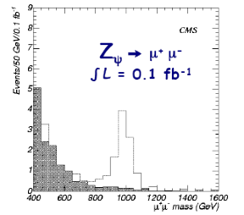
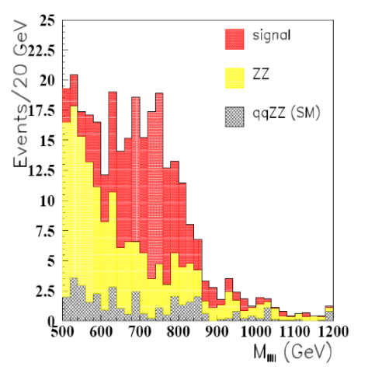
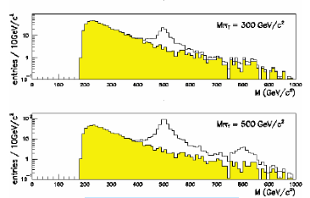
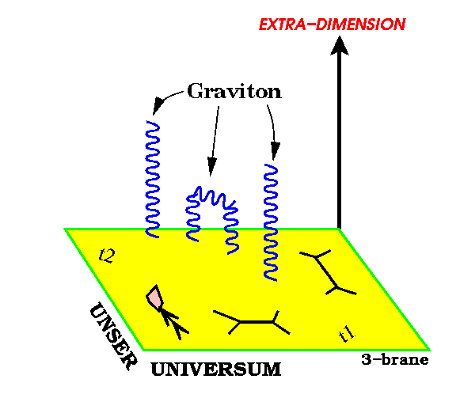
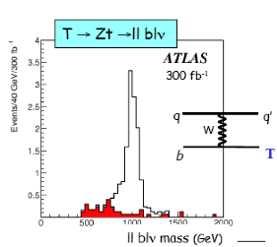
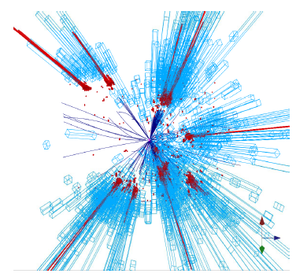
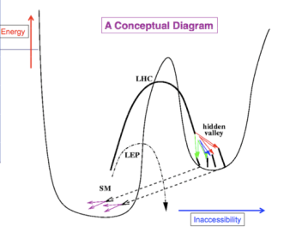
Anomalies beyond the Standard Model?
New Gauge Bosons
Supersymmetry
ZZ/WW resonances
Technicolor
Little Higgs
Extra Dimensions
Hidden Valleys
Black Holes
A large variety of possible signals
Notes:
17

Slide 18
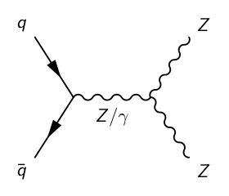
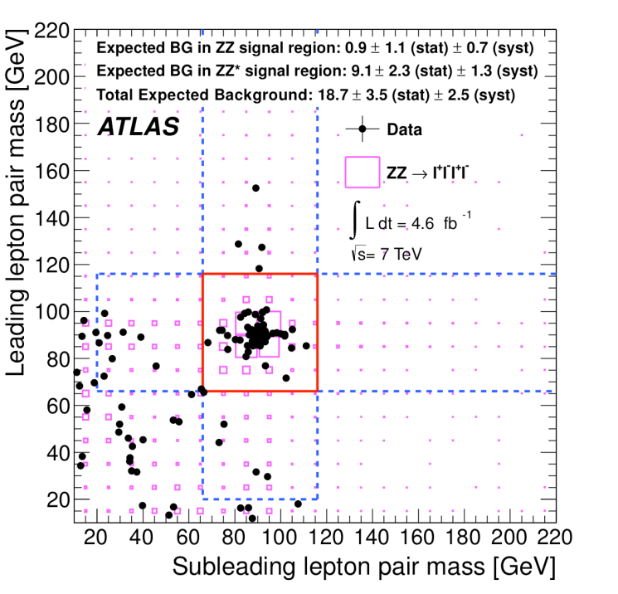
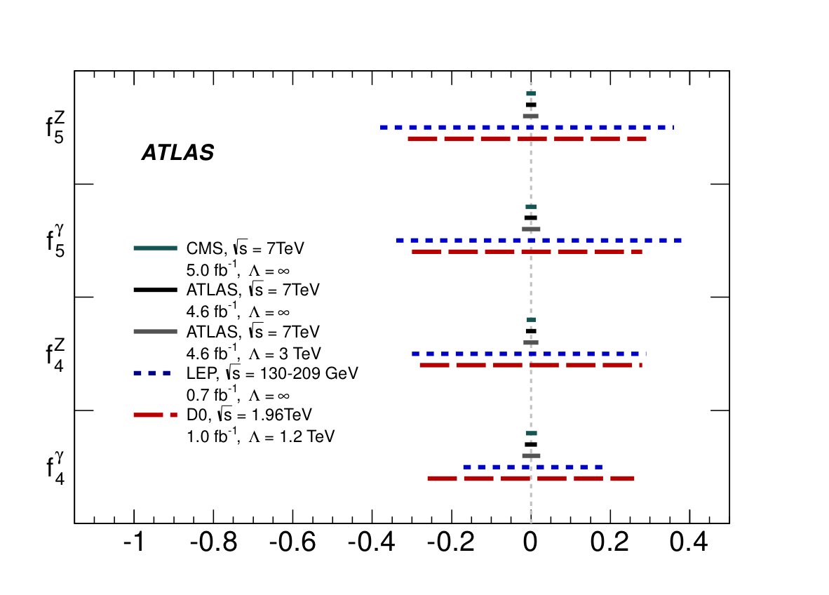
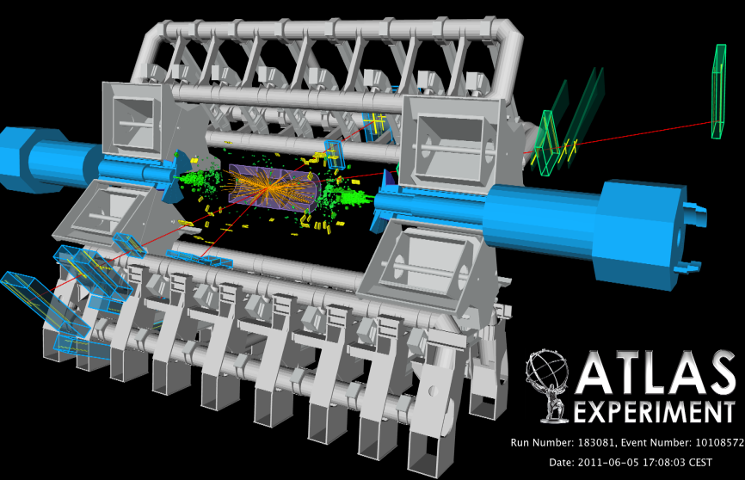
ZZ anomalous gauge couplings
arXiv: 1211.6096
ZZZ and ZZγ TGC vertices do not exist in the SM
Only three parameters - G_{F}, α and sin²(θ_{w}) - determine all couplings
New ATLAS and CMS limits improve earlier limits by an order of magnitude
A ZZ*→4μ event m_{Z,1}=90.6 GeV, m_{Z*,2}=47.4 GeV (m_{4μ}=143.5 GeV)
Similarly limits on anomalous TGCs in WZ

Slide 19
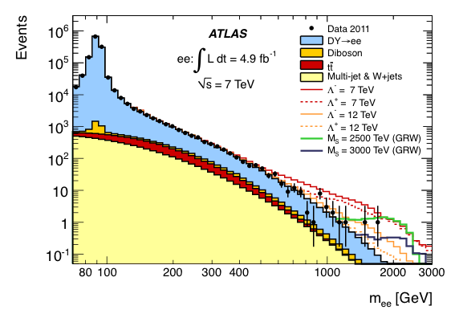
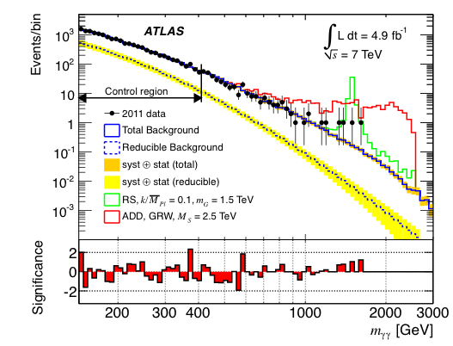
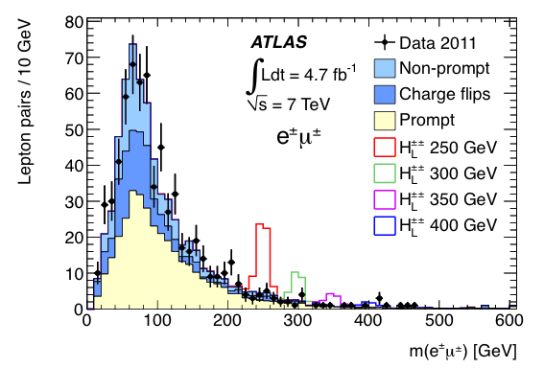
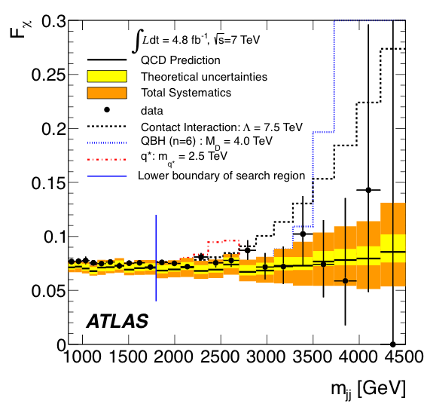


Among 7 TeV results..
More on next slides
Z’, Z*,
RS G*, CI, …
RS G*, LED
H±±
q*, CI,
QBH, …
4th gen. t’
vector-like t’
top+jet resonance

Slide 20




top+jet resonance in tt+jet events
Φ
q
Latest CDF measurement of tt A_{FB} shows a 3.4σ deviation.
No direct comparison possible at pp colliders, but expect effects in top+jet
[ ATLAS 1 fb⁻¹ 7 TeV tt A_{c}: data consistent with MC@NLO ]
Change in tt+jet contribution can affect A_{FB}: W’ -> tq, Φ -> tq.
Signal region in [m_{tj} , m_{tj} ] plane (asymmetric).
q
A_{FB} in tt frame (CDF)
20

Slide 21



Z’ → ee, μμ
First 8 TeV results on Z’ → ee, μμ are available from both CMS [4 fb⁻¹, EXO-12-015] and ATLAS [6 fb⁻¹, CONF-2012-129]
Example 95% CL Limits :
m(SSM Z’) > 2.59 TeV [CMS]
> 2.49 TeV [ATLAS]
m(ll)

Slide 22


Z’ → ττ
Both ATLAS/CMS have results for full 2011 dataset (5 fb⁻¹ @ 7 TeV)
  Analyses combine e+μ, e+h, μ+h, and h+h channels
95% CL Limits (5 fb⁻¹ @ 7 TeV):
m(SSM Z’) > 1.4 TeV [CMS]
> 1.3 TeV [ATLAS]
    ATLAS arXiv:1210.6604
    CMS PLB 07, 062 (2012)

Slide 23


Randall-Sundrum G → γγ
In a similar way, the high mass tail of the diphoton mass spectrum can be searched for evidence of RS graviton decay
  γγ has 2x higher BR (and lower bkgd since no DY) than leptonic modes
  γγ decay would eliminate spin-1 interpretation of any new resonance
ATLAS and CMS have published γγ results with ~ 2 fb⁻¹ @ 7 TeV
  ATLAS has updated result, combining γγ/ee/μμ for 5 fb⁻¹ @ 7 TeV
  Limits set in plane of dimensionless coupling (k/M_{PL}) versus m(G)
m(RS G) > 2.23 TeV (for k/M_{PL} = 0.10) @ 95% CL ATLAS (arXiv:1210.8389)

Slide 24


Excited Leptons
Excited lepton production depends on the compositeness scale, Λ
ATLAS (CONF-2012-008) and CMS (arXiv:1210.2422) both have limits using full 2011 dataset (5 fb⁻¹ @ 7 TeV)
  Shown below in Λ vs m(l*) plane are new ATLAS results using 13 fb⁻¹ @ 8 TeV
95% CL Limits [ for Λ = m(l*) ] :
m(e*) > 2.2 TeV m(μ*) > 2.2 TeV [ATLAS] (CONF-2012-146)

Slide 25


Leptoquarks (First and Second Generation)
Final states of eejj or eνjj (μμjj or μνjj), with weights which depend on β
  ATLAS has 1 fb⁻¹ @ 7 TeV results [PLB 709 (2012) 158; EPJ C72 (2012) 2151]
  Shown below are CMS 5 fb⁻¹ @ 7 TeV results in comparison
CMS 95% CL limits with 5 fb⁻¹ @ 7 TeV :
  m(LQ1) > 830 GeV for β = 1 [PRD 86, 052013 (2012)]
  m(LQ2) > 840 GeV

Slide 26


Leptoquarks (Third Generation)
CMS results with 5 fb⁻¹ @ 7 TeV:
LQ3 → b + τ [arXiv:1210.5629]
e/μ + h channels
  m(LQ3) > 525 GeV for β = 1
  New ATLAS result, 5 fb⁻¹ @ 7 TeV :
LQ3 → b + τ [EXOT-2012-14]
e and μ decay channels of the τ
  m(LQ3) > 538 GeV for β = 1

Slide 27


Excited Quarks
As for leptons, could have high mass “excited” quarks
  As for l*, consider EM decays, i.e. q* → q + γ (jet+photon) resonances
ATLAS result for 2.1 fb⁻¹ @ 7 TeV
m(q*) > 2.46 TeV
[PRL 108, 211802 (2012)]

Slide 28


Dijet Resonances
A variety of BSM models include dijet resonances of various types
  Both ATLAS/CMS have released search results with 8 TeV data
  Approaching the limits of phase space
CMS 4 fb⁻¹ @ 8 TeV [EXO-12-016] ATLAS 13 fb⁻¹ @ 8 TeV [CONF-2012-148]

Slide 29



-
tt Resonance Search
Reconstruct semileptonic tt events
Examine m(tt) distribution for possible resonances
Limits on
  narrow resonance: topcolour Z'→tt in a leptophobic scenario
  wide resonance (RS model) g_{KK}→tt
Limits on σ.B in few pb range for m_{tt} ~ 1 TeV

Slide 30

Dijet Resonances
CMS 4 fb⁻¹ @ 8 TeV dijet result interpreted in a number of different models [EXO-12-016]
ATLAS has new result with 13 fb⁻¹ @ 8 TeV : 95% CL limit of
m(q*) > 3.84 TeV [CONF-2012-148]
LHC dijet resonance searches typically consider dijet masses above ~ 1 TeV

Slide 31












ATLAS Summary
l±l’±
l+jets
l+jets
ττ
lljj
llγ
lν
7 TeV analyses to be concluded soon.
First results on 8 TeV data.
No sign of new physics so far, but
lots of 8 TeV analyses in the pipeline..
γγ
jj
jets
ll
γ+E_{T}^{miss}
jet+E_{T}^{miss}
ll’+E_{T}^{miss}

Slide 32

CMS Summary
95% CL Exclusion Limits [TeV]
7 TeV

Slide 33
ATLAS Summary
Vast number of models investigated in large number of topologies… but only fraction of data investigated in various cases…
Surprises might be waiting in the present data, and/or data to come at higher energy in 2015
Exotics Models:
Extra dimensions:
RS KK Graviton
(dibosons, dileptons, diphotons)
RS KK gluons (top antitop)
ADD (monojets, monophotons,
dileptons, diphotons)
KK Z/gamma boosns (dileptons)
Grand Unification symmetries
(dielectons, dimuons, ditaus)
Leptophobic topcolor Z' boson
(dilepton ttbar, l+j, all had)
S8- color octet scalars (dijets)
String resonance (dijets,)
Benchmark Sequential SM Z', W'
W' (lepton+MET, dijets, tb)
W* (lepton+MET, dijets)
Quantum Black Holes (dijet)
Black Holes (l+jets, same sign leptons)
Technihadrons (dileptons, dibosons)
Dark Matter
WIMPs (Monojet, monophotons)
Excited fermions
q*, Excited quarks (dijets, photon+jet)
l*, excited leptons (dileptons+photon)
Leptoquarks (1st, 2nd, 3rd generations)
Higgs -> hidden sector
(displaced vertices, lepton jets)
Contact Interaction
llqq CI
4q CI (dijets)
Doubly charged Higgs (
multi leptons, same sign leptons)
4th generation
t'->Wb, t'->ht, b'-Zb, b'->Wt
(dileptons, same sign leptons, l+J)
VLQ-Vector Like quarks
Magnetic Monopoles (and HIP)
Heavy Majorana neutrino and RH W

Slide 34





Dali Higgs – which picture do you prefer?
SUrrealSY

Slide 35



Electroweak Fit
No apparent tensions
between m_{H} and
{m_{W} m_{t} }
Possible due to
• precision measurements
• known higher order electroweak corrections
Quadratic ,Logarithmic

Slide 36


MSSM
5 Higgs bosons
( 3 neutrals and 2 charged )
couplings to down
part of doublets
( b , τ , μ ) enhanced
at high tan(β)
D.Rainwater hep-ph/0702124
MSSM
at LO MSSM Higgs sector depends on 2 parameters
M_{A} tan(β) ( = v2/ v1)
at NLO more SUSY parameters
A (0⁻) does not give H ZZ and WW

Slide 37


Supersymmetry
Conventional method to fix Higgs mass
Double the number of states in model
Fermion/boson loops cancel
Help to unify forces
105 new parameters (MSSM)
→ 13(+6) → 7 → 6 → 5 → 4
R-parity conservation → LSP (dark matter candidate) → missing energy signatures

Slide 38
Particle Masses
top quark
Mass proportional to area:
ν_{e} ν_{μ} ν_{τ} e μ τ u d s c b
. . .
Higgs
photon
gluons
Z
W
. . .
. . .
. . .
Higgs - self-consistent standard model - preserve gauge symmetry
Need a Yukawa interaction to incorporate individual fermion masses
Need QCD to generate massive nucleons from light u, d quarks

Slide 39


SUSY Landscape?
8 TeV
GUT
7 TeV
ATLAS-CONF-2012-109
SUSY
Key signatures:
Jets (>=2-6 jets in this analysis) pT 1,2(N)> 100 (20)GeV
E_{t}^{miss} /meff ~ 0.3
Simplified MSSM scenario with only strong production of gluinos and first- and second-generation squarks, with direct decays to jets and neutralinos
SM

Slide 40


SUSY Particle Masses?
Mass proportional to area:
Mass hierarchy?:
Squarks?
Gluinos?
Shiggs?
Gauginos?

Slide 41


SUbtleSY
SUSY?
The
scalar
precipice
StretchedUSY?
EW scale^{—1}
8 TeV
Higgs
7 TeV
ATLAS-CONF-2012-109
e.g. Limits from this model:
M(squarks, gluinos) >~ 1-2 TeV
More prolematic than ever
SUbtleSY
GUT scale^{—1}
Fundamental scalar length scale

Slide 42




Natural” SUSY
Lightest squarks are stop/sbottom, gluinos possibly too heavy, gauginos accessible ?
1208.2884, 1208.3144, ATLAS-CONF-2012-154
Lower cross-sections and larger SM backgrounds require dedicated searches
Associated gaugino production
~
~
~
~
Gluino-mediated b/t production
Direct b/t pair production
Direct slepton-pair production

Slide 43
Searching for “natural” SUSY with Tops
ATLAS-CONF-2012-166
ATLAS-CONF-2012-167
Seeking solutions to stabilise the Higgs mass… Hierarchy problem
Significantly improved sensitivity at high stop masses with expected limits up to 620 GeV

Slide 44
Searching for SUSY with Tops
ATLAS-CONF-2012-166
ATLAS-CONF-2012-167
Seeking to Solve the Hierarchy Problem…
Complemented in the lower mass range by:
Significantly improved sensitivity at high stop masses with expected limits up to 620 GeV
Also, strongly enhanced sensitivity for lower mass stop decaying into b + chargino

Slide 45
ATLAS-CONF-2012-166
ATLAS-CONF-2012-167
Seeking to Solve the Hierarchy Problem…
Searching for SUSY with Tops
Complemented in the lower mass range by:
Significantly improved sensitivity at high stop masses with expected limits up to 620 GeV
Also, strongly enhanced sensitivity for lower mass stop decaying into b + chargino

Slide 46







Natural” SUSY
Search for direct top squark pair production
8 TeV
SUS-12-023
Search for supersymmetry in final state with E_{T} and 0,1,2,3, >= 4 b jets
No excess in data observed above expected SM background.
8 TeV
SUS-12-028
Exclusion for pair-produced gluinos, each decaying to a bottom quark-antiquark pair and a neutralino LSP.
Notes:
Sbotton e stop low mass in order to be the source of the Naturaless…
All final states with stop and sbotton
SUS-12-023
This note presents a search for top squark pair production in events with a single isolated electron or muon, jets, and large missing transverse energy. At least one of the jets is required to be identified as originating from a b-quark and events are required to have large transverse mass. The data sample used corresponds to an integrated luminosity of 9.7 fb⁻¹ of pp collisions, collected in 2012 by the CMS experiment at the LHC, at a centre-of-mass energy of 8 TeV. No significant excess in data is observed above the expected standard model backgrounds. The results are interpreted in the context of models of top squark pair production where the top squarks decay either to a top quark and a neutralino or to a bottom quark and a chargino. Depending on the decay mode, the results probe top squarks with masses in the range of 160–430 GeV.
Analysis Summary
The search presented focuses on two decay modes of the top squark (t ̃): t ̃ → tχ ̃0 and t ̃ →bχ ̃± → bWχ ̃0, which are expected to have large branching fractions if kinematically accessible. The signature of the signal process includes high transverse momentum jets, including two b-jets, and missing ET. The selection applied requires exactly one isolated, high pT electron or muon, at least 4 jets, out of which at least one is b-tagged, and missing ET. We search for an excess of events with large transvere mass (MT) since the largest backgrounds in the single lepton topology contain a single leptonically-decaying W boson, and the MT of the lepton-neutrino system has a kinematic endpoint requiring MT < MW. For the signal, the presence of additional LSP’s in the final state allows MT to exceed MW. The dominant background in this kinematic region is dilepton tt where one of the leptons is not identified, since the presence of the additional neutrino from the second leptonically-decaying W boson allows MT to exceed MW .Seven signal regions are defined, based on missing ET and MT requirements, in order to be sensitive to a range of signal kinematics, dependent on the masses of the top squark and LSP. Backgrounds are estimated from Monte Carlo, with scale factors (where necessary) derived in control regions. The control regions are used to validate the background modeling in the MC and derive the systematic uncertainties on the backgrounds. Agreement is observed between the data and the predicted backgrounds for all signal regions. The results are interpreted in the context of simplified SUSY models where the stops decay to top-neutralino or b-chargino and are used to place constraints on the stop mass.
Figure up
Interpretation in the top squark pair production model with t ̃ → tχ ̃0, in the plane of m(χ ̃0) vs. m(t ̃). The t ̃ decay matrix element is treated as flat, which is equivalent to the assumption of 50/50 mixing of left-handed and right-handed top super partners. The upper limits on the signal cross section are calculated separately for each signal region, incorporating the uncertainties in the signal acceptance and efficiency, using the LHC-type CLs criterion. For each point in the signal model parameter space, the observed limit is taken from the signal region with the best expected limit. The shading indicates the resulting upper limit on the signal cross section. The observed, median expected, and ±1σ expected exclusion contours are indicated assuming NLO-NLL cross sections, as well as the observed contours when the theory cross section is varied by ±1σ (the region below the contours is excluded).
Figure down
Interpretation in the top squark pair production model with t ̃ → bχ ̃± → bWχ ̃0, in the plane of m(χ ̃0) vs. m(t ̃), for the mass of the intermediate charginoχ ̃± specified by the parameter x=0.5, where m(χ ̃±) = x m(t ̃) + (1−x) m(χ ̃0) i.e. the χ ̃± mass is half way between the t ̃ and χ ̃0 masses. The t ̃ decay matrix element is treated as flat, which is equivalent to the assumption of 50/50 mixing of left-handed and right-handed top super partners. The upper limits on the signal cross section are calculated separately for each signal region, incorporating the uncertainties in the signal acceptance and efficiency, using the LHC-type CLs criterion. For each point in the signal model parameter space, the observed limit is taken from the signal region with the best expected limit. The shading indicates the upper limit on the signal cross section. The observed,median expected, and ±1σ expected exclusion contours are indicated assuming NLO-NLL cross sections, as well as the observed contours when the theory cross section is varied by ±1σ (the region below the contours is excluded).
SUS-12-028
A search for supersymmetry in final states with jets and missing transverse energy is performed in pp collisions at a centre-of-mass energy of 8 TeV. The data sample corresponds to an integrated luminosity of 11.7/fb collected by the CMS experiment at the LHC. In this search, a dimensionless kinematic variable, AlphaT, is used as the main discriminator between events with genuine and misreconstructed missing transverse energy. The search is performed in a signal region that is binned in the number of jets, the scalar sum of the transverse energy of these jets, and the number of jets identified as originating from a bottom quark. No excess of events over the standard model expectation is found. Exclusion limits are set in the parameter space of simplified models, with a special emphasis on compressed spectra and third-generation scenarios.
The plots below show the excluded cross section versus model spectrum for various simplified models. The colour scale indicates the observed cross section upper limit (95% CL) as a function of the mass of the produced particle (gluino or squark) and the LSP mass. The point-to-point fluctuations are due to the finite number of pseudo-experiments used to determine the observed upper limit. The thick solid black line indicates the observed exclusion region assuming nominal NLO+NLL SUSY production cross section for pair-produced gluinos in the limit of very massive squarks (or vice versa). The thin black lines represent the observed excluded region when varying the production cross section by its theoretical uncertainty. The dashed purple lines indicate the median (thick line) +/- 1 sigma (thin lines) expected exclusion regions. Only certain categories of (Njet,Nb) are considered for each simplified model, as summarised below.

Slide 47


What about Dark Matter ?
Detection of invisible particle production
1210.4491, ATLAS-CONF-2012-147
Should we give up on natural SUSY and directly search for WIMP (dark matter) production in proton−proton collisions ?
Exploit “ISR technique” (huge potential)
Energetic gluon/photon radiation in the initial sate
→ Search for mono-jets events
Interpretation in variety of models:
extra dimensions, WIMP, gravitinos

Slide 48

What about Dark Matter ?
Detection of invisible particle production
1210.4491, ATLAS-CONF-2012-147
Should we give up on natural SUSY and directly search for WIMP (dark matter) production in proton−proton collisions ?
Exploit “ISR technique” (huge potential!)
Energetic gluon/photon radiation in the initial sate
→ Search for mono-jets events
Complementarity between accelerator-based and space-based particle physics

Slide 49
Overview of SUSY Searches
Vast number of SUSY models studied… Concentrating on the most “Natural ” scenarios
Still many analyses to be completed with 8 TeV data, surprises might be waiting in the present data, and/or data to come at higher energy in 2015
1 TeV
squarks & gluinos
3rd gen squarks
EW
LLP
RPV
Other

Slide 50


Higgs Discovery and Properties
(including latest LHC data)
ATLAS Higgs Search
CMS Higgs Search

Slide 51






Ginzburg-Landau
Historical Perspective
Nambu
Goldstone
1961 Schwinger
1962 Anderson
1964 Brout, Englert, Higgs, Guralnik,Hagen,Kibble
1967 Weinberg, Salam Faddeev,Popov
Glashow, Iliopoulos,
Maiani, ‘t Hooft, Veltman…..
1983 Rubbia, van der Meer, Banner, Darriulat, Di Lella, … discovery of W and Z at CERN
1984 Lausanne
1989 construction of the LEP ( e+ e- collider ) tunnel finished
beginning of the R & D of LHC experiments
1992
1994
1995
1996
1998
1999
2006
2008
2010
2012
LOI of ‘large’ LHC experiments
TP of ATLAS and CMS approval of LHC
discovery of top by CDF and D0
approval of LHC in one step
approval of the 4 largest LHC experiments (ATLAS,CMS, LHCb, ALICE)
ATLAS Physics TDR CERN/LHCC/99-14 CERN/LHCC/99-15
CMS Physics TDR J. Phys. G: Nucl. Part. Phys. 34 (2007) 995–1579
ATLAS Expected Performance arXiv:0901.0512
start-up at 3.5 + 3.5 TeV
4th July discovery of boson

Slide 52


Where Theory Meets Experiment

Slide 53







10th september 2008 : first beams around
19th september 2008 : incident
2008
14 months of major repairs
New Quench Protection system
2009
20th november 2009 : first beams around (again)
december 2009 : collisions at 2.36 TeV cms
January 2010 : decided scenario 2010-11 7 TeV cms
instead of 14 TeV
2010
30th march 2010 : first collisions at 7 TeV cms
august 2010 : luminosity of 10³¹ cm⁻² s⁻¹
2011
may 2011 : luminosity > 10³³ cm⁻² s⁻¹
november 2011 : integrated luminosity ~ 5 fb⁻¹
13th december 2011 : first ‘signal’ around 126 GeV
march 2012 : start again at 8 TeV
4th July 2012 : evidence for a new boson
( integrated luminosity ~ 6 fb⁻¹ )
2012
11th December 2012: Milner Foundation: Special Fundamental Physics Prize
18th December 2012: XVIII IFT-UAM/CSIC Christmas Workshop

Slide 54





July 2012 Revolution
NewWorld
Old World

Slide 55







A.Djouadi Phys.Rept.457:1-216
Huge progress in theory: signals and (complex) backgrounds
Major achievement of the theory community; very fruitful discussions with the experiments (e.g. through LHC Higgs x-sn WG,LPCC..)
GF H → WW , ZZ , γγ , bb,ττ
VBF H → WW, ZZ , γγ , ττ
Typical uncertainties on cross-section
gg +15 -20 % NNnLO
VBF 5% NLO
WH,ZH 5% NNLO
ttH 15% NLO
H → WW, γγ, bb
These production cross sections are used
with the decays bb , ττ , WW , ZZ , γγ
H → WW, γγ, bb

Slide 56

H → ZZ, WW , bb, ττ, γγ
Highlights of Higgs Analyses
From Discovery to Measurements
I. (nano) Review of Recent Results on SM Higgs Channels
II. Update of Higgs analyses in H → γγ and H → 4l Channels
III. First Spin and Parity Studies

Slide 57




Higgs
Jul 4th 2012
HCP Nov 2012
CMS performance increase:
Sensitivity up from 5.8 to 7.8 σ

Slide 58

H → ττ
Reoptimised 7+8 TeV analysis
ATLAS-CONF-2012-160
H → τ_{had}τ_{had} candidate in VBF channel (m_{MMC} = 131 GeV)
ττ channel basic facts sheet :
Signal (SM) | Signal purity s/b | Main backgrounds | Production | 7 & 8 TeV
~330 | 0.3% - 30% | ZZ, Z+jets, top | VBF, Hgg, VH | 4.9 & 13 fb⁻¹

Slide 59

VH production with H → bb
Combined and reoptimised 7+8 TeV analysis
VH(bb) channel basic facts sheet :
Signal (SM) | Signal purity s/b | Main backgrounds | Production | 7 & 8 TeV
~50 | ~1% - 10% | Wbb,Zbb, top, etc… | VH | 4.9 & 13 fb⁻¹

Slide 60



Fermions
HIG-12-044
Mild excess of 2.2 σ building up
Coherent picture between the sub channels Z(ll)H(bb); Z(νν) H(bb); W(lν) H(bb) need more statistics
VH → Vbb
HIG-12-043
H → τ τ
All including VH
VH → Vτ τ
Very small contribution
HIG-12-051
Very mild excess is building up at 1.3 σ level
Notes:
HIG-12-044
A search for the standard model Higgs boson (H) decaying to bb when produced in association with a weak vector boson (V) is reported for the following modes: W(μν)H, W(eν)H, Z(μμ)H, Z(ee)H and Z(νν)H. The search is performed in a data sample corresponding to an integrated luminosity of 5.0 fb−1, recorded by the CMS detector in proton-proton collisions at the LHC with a center-of-mass energy of 7 TeV during 2011, and in a data sample of up to 12.1 fb−1 of 8 TeV collisions during 2012. Upper limits, at the 95% confidence level, on the VH production cross section times the H → bb branching ratio, with respect to the expectations for a standard model Higgs boson, are derived for a Higgs boson in the mass range 110–135 GeV. In this range, the observed upper limits vary from 1.0 to 4.7 times the standard model prediction; the corresponding expected limits vary from 0.9 to 1.9. At a Higgs boson mass of 125 GeV the observed limit is 2.6 and the expected limit is 1.2. The excess of observed events is 2.2 standard deviations from what is expected from background alone, and is consistent with the standard model prediction for Higgs boson production.
Picture
Expected and observed 95% CL upper limits on the product of the VH production cross section times the H → bb branching ratio, with respect to the expectations for a standard model Higgs boson. The median expected limit and the 1- and 2-σ bands are obtained with the LHC CLs method as implemented in RooStats, as are the observed limits at each mass point. The limits are combined for the 2011 7 TeV and the 2012 8 TeV data.
HIG-12-043
A search for the standard model Higgs boson decaying to tau pairs is performed using events recorded by the CMS experiment at the LHC in 2011 and 2012 at a center-of-mass energy of 7 and 8 TeV respectively. The dataset corresponds to an integrated luminosity of 17 fb⁻¹, 4.9 fb⁻¹ of data taken at 7 TeV center-of-mass energy and 12.1 fb⁻¹ at 8 TeV. The tau-pair invariant-mass spectrum is studied in five different final states, and . Upper limits with respect to the standard model prediction in the mass range of 110-145 GeV are determined. An observed (expected) 95% confidence level exclusion limit for = 125 GeV is found to be 1.63 (1.00) times the standard model cross section.
Picture
The expected one- and two-standard-deviation ranges and observed 95% CL upper limits on cross section normalized to the SM expectation as a function of . The results from the associated production channels are not included here.
To search for the presence of a Higgs boson signal in the selected events, we perform a binned maximum likelihood fit to the tau-pair invariant-mass spectrum. The fit is performed jointlyacross the five final states with two or five event categories each.
HIG-12-051
A search for the standard model Higgs boson decaying to tau pairs is presented using data collected in 2011 and 2012 with the CMS detector at the LHC. The topologies studied represent three or four lepton final states, where the Higgs boson is produced in association with the leptonic decay of a W or Z boson, respectively. The analyses use collision data samples corresponding to integrated luminosities of 5 fb⁻¹ collected at √s = 7 TeV and 12 fb⁻¹ of 8 TeV. Upper limits between 2.7 and 5.5 times the standard model prediction are established on the product of Higgs boson cross section and tau pair decay branching fraction for Higgs masses between 110 and 145 GeV.
Picture
Observed and median expected 95% CL upper limits on SM Higgs production set by the combination of analyses presented in the note.

Slide 61

H → WW⁽*⁾
eµ + 2ν
0,1 jet Channel
ATLAS-CONF-2012-158
Most sensitive channel over ~ 130-180 GeV (σ ~ 200 fb)
However: challenging: 2ν → no mass reconstruction/peak → “counting channel”
2 isolated opposite-sign leptons, large E_{T}^{miss}
Main backgrounds: WW, top, Z+jets
→ m_{ll} ≠ m_{Z}, b-jet veto, …
→ Topological cuts against “irreducible” WW background:
p_{Tll}, m_{ll}, Δϕ_{ll} (smaller for scalar Higgs), m_{T} (ll, E_{T}^{miss})
WW channel basic facts sheet :
Signal | Signal purity s/b | Main backgrounds | Production | 8 TeV
~110 | ~10% | WW, W+jets, top, etc… | ggH | 13 fb⁻¹

Slide 62

H → WW⁽*⁾ → eµ + 2ν
ATLAS-CONF-2012-158
Different-flavour channel and 8 TeV (13 fb⁻¹) 0 and 1-jet
Transverse mass (signal region)
Background subtracted transverse mass
Main discrimination with: m_{ll}, Δf_{ll}, m_{T}
Main backgrounds estimated from control regions
μ = σ/σ_{SM}
Signal strength:
μ(125 GeV) = 1.5 ± 0.6
Observed Significance (125 GeV): 2.6σ
Expected Significance : 1.9σ
Ratio of measured event yield to that expected from the Standard Model Higgs signal

Slide 63

H → WW⁽*⁾
7 TeV L=5.1 fb⁻¹, 8 TeV, L=12.2 fb⁻¹
WW→2l2ν
HIG-12-042
2011+2012
Significant excess
Observed: 3.1 σ and expected: 4.1 σ
Notes:
-Z -> 4 l is a standard candle that shows good agreement
and high performance in reconstructing 4 lepton candidates
-Maybe one can stress that the Z peak represents a
cross check on how well we trust what we see in 125
GeV(ATLAS doesnt have it)
HIG-12-041
Measurements of the properties of the new boson recently observed at a mass near 125 GeV in the CMS experiment are reported. The results are obtained from a comprehensive search for the standard model Higgs boson in the H → ZZ decay channel, where both Z's decay to electron, muon, or tau lepton pairs. The search covers Higgs boson mass hypotheses in the range 110<mH<1000 GeV. The analysis uses pp collision data recorded by the CMS detector at the LHC, corresponding to integrated luminosities of 5.1 fb−1 at s√=7 TeV and 12.2 fb−1 at s√=8 TeV. The new boson is observed with a local significance above the expected background of 4.5 standard deviations. The signal strength μ, relative to the expectation for the standard model Higgs boson, is measured to be μ=0.80+0.35−0.28 at 126 GeV. A measurement of its mass gives 126.2±0.6 (stat) ±0.2 (syst)~GeV. The hypothesis 0+ of the standard model for the spin J=0 and parity P=+1 quantum numbers is found to be consistent with the observation. Under the assumption that the observed boson has spin zero the data disfavor the pseudoscalar hypothesis 0− with a CLs value of 2.4\%. No other significant excess is found, and upper limits at 95\% confidence level exclude the ranges 113--116 GeV and 129--720 GeV while the expected exclusion range for the standard model Higgs boson is 118--670 GeV.
Golden channel
Analysis telegram
4 isolated high pT leptons
consistent with Z decays
from same vertex
fit mass peak with resolution: 2-4 GeV
little background, non-resonant ZZ production
also Zbb and top (2l2nu2b)
Background removal
- Leptons from b decays are non isolated and displaced
Analysis with only minor modifications since ICHEP
Picture
Distribution of the four-lepton reconstructed mass in [70-180] GeV mass range (3 GeV bin) for the sum of the 4e, 4μ, and 2e2μ channels. Points represent the data, shaded histograms represent the background and unshaded histogram the signal expectations. The distributions are presented as stacked histograms. The measurements are presented for the sum of the data collected at √s = 7 TeV and √s = 8 TeV.
Kinematics of the Higgs or exotic boson decay to ZZ final state has been extensively studied in
the literature [31, 64–76]. Since the Higgs boson is spinless, the angular distribution of its decay
products is independent of the production mechanism. Five angles ∼Ω = (θ,Φ1, θ1, θ2,Φ),
defined in Ref. [31], and the invariant masses of the lepton pairs, mZ1 and mZ2 , fully describe
the kinematics of the H ! ZZ ! 4` process at a given mass of the four-lepton system in their
centre-of-mass frame. These observables provide significant discriminating power between
signal and background.
We use a matrix element likelihood analysis (MELA). We construct a kinematic discriminant
(KD) based on the probability ratio of the signal and background hypotheses, MELA KD =
Psig/(Psig + Pbkg),
HIG-12-042
An update of a previous search for the standard model Higgs boson decaying to W⁺W⁻ in pp collisions at √s = 8 TeV is reported. The event sample corresponds to an integrated luminosity of 12.1 ± 0.5 fb⁻¹, collected by the CMS detector at the LHC in 2012. The 2011 results obtained at √s = 7 TeV for an integrated luminosity of 4.9 fb⁻¹ are added to the present analysis. The W⁺W⁻ candidates are selected in events with two oppositely charged leptons and large missing transverse momentum. An excess of events is observed above background which is consistent with the expectations from a standard model Higgs boson of mass 125 GeV and has a statistical significance of 3.1 standard deviations for this mass. This result provides evidence for a Higgs-like particle decaying to W⁺W⁻. No other excess of events is observed over the full accessible mass range. Additional standard model Higgs-like bosons are excluded in the mass range 128-600 GeV at 95 % confidence level.
Main results
A search has been made for a Higgs boson decaying in a pair of W bosons in the CMS detector at √s = 8 Tev. Events are classified according the exclusive jet multiplicity: 0, 1 and 2. The analysis of events with 0, 1 jets is optimized for gg → H → WW, while the one for events with 2 jets is optimized for Vector Boson Fusion (VBF) qq → H → WW. The events are further separated in same-flavor and different-flavor final states in each jet multiplicity. The main backgrounds (W⁺W⁻, top, Drell Yan, W+jets) are estimated with data-driven techniques. The uncertainty on the background normalization represent the largest source of systematics of the analysis, together with the theoretical uncertainties on the Higgs cross section.
A cut and count analysis is performed, optimized for each mass point in all jet multiplicity categories. The same-flavor final states have limited sensitivity to the signal and introduce a large systematic uncertainty due to the larger fake missing ET background in events with high pile-up. A 2D shape analysis of the di-leplon invariant and transverse masses for the different-flavor final state in the 0-jet and 1-jet categories which increase the sensitivity to the standard model Higgs boson is performed and combined with the cut and count analysis in the same-flavor final state in the 0-jet and 1-jet categories and the VBF category.
The search discussed here is performed over the mass range 110--600 GeV, and the data sample corresponds to 12.1fb-1 of integrated luminosity collected in 2012 at a center-of-mass energy of 8 TeV. Finally, the 7 TeV data sample is added to the analysis to obtain the combined 2011 and 2012 results. An excess of events is observed above background which is consistent with the expectations from a standard model Higgs boson of mass 125 GeV, corresponding to:
Observed (expected) significance for mH = 125 GeV in terms of standad deviations ==> 3.1 (4.1)
best fit value of the signal strengh for mH = 125 GeV ==> 0.74 +/- 0.25
No other excess of events is observed over the full accessible mass range. Additional standard model Higgs-like bosons are excluded in the mass range 128-600 GeV at 95 % confidence level.
H→WW→2l2nu
Signature
2 opposite charged leptons (leptons only e, mu)
2 neutrinos == missing transverse energy (MET)
No Higg mass peak
Basically a counting analysis
Analysis challenges
-understand backgrounds
- Normalize to control regions
- backgrounds:WW, W+jets, top, DY
Picture
Expected and observed 95% CL upper limits on the cross section times branching fraction, relative to the SM Higgs expectation, for the combined 8 TeV shape-based analysis together with the analysis performed at 7 TeV. The expected limits in the presence of the Higgs with mH = 125 GeV and its associated uncertainty are also shown.

Slide 64

H → γγ Update
Since “Discovery Paper” PLB 716
ATLAS-CONF-2012-168
Small cross-section: σ ~ 40 fb
Simple final state: two high-p_{T} photons
E_{T} (γ₁, γ₂) > 40, 30 GeV
Main background: γγ continuum (irreducible, smooth, ..)
Events divided into categories based on η-photon
(e.g. central, rest, …), converted/unconverted, p_{T}^{γγ} along thrust axis
γγ channel basic facts sheet :
Signal (SM_{126 GeV}) | Signal purity s/b | Main backgrounds | Production | 7 & 8 TeV
~330 | 2% - 20% | γγ,γj and jj | Hgg, VBF, VH | 4.9 & 13 fb⁻¹

Slide 65

H → γγ
Simple topology: two high-p_{T} isolated photons E_{T} (γ₁, γ₂) > 40, 30 GeV
To increase sensitivity, overall and to specific production processes 12 exclusive categories:
  γ rapidity, converted/unconverted γ, p_{Tt}(p_{T}^{γγ} perpendicular to γγ “thrust” axis)
  presence of 2 high-mass (m_{jj} 400 GeV) forward jets target VBF process
  1 lepton → target W/Z/ttH
  Low-mass di-jet (60 <m_{jj}<100 GeV) jets → target W/ZH
  NEW since PLB716
Stability of EM calorimeter response vs time
(and pile-up) <0.1%

Slide 66
H → γγ Signal Confirmation and Single Channel Discovery
Observed local significance:
Expected local significance:
126.0 GeV 3.5σ (exp. 1.6σ)
127.0 GeV 5.1σ (exp. 2.9σ)
H → γγ signal is confirmed

Slide 67
H → γγ mass measurement
ATLAS-CONF-2012-168
Measurement of a narrow resonance:

Slide 68

H → γγ Signal Strength
ATLAS-CONF-2012-168
Measurement of signal strength :
(at best fit mass 126.5 GeV)
Signal strength for different production modes :
Fermion couplings dominated modes
ggH+ttH
1.7, 2.0
Vector boson dominated modes
VBF+VH

Slide 69

Spin Analysis in the H → γγ Channel
0⁺ vs 2⁺
Using the inclusive analysis
- Sensitive variable is dihoton cos θ* distribution
- Use events within 1.5σ of the peak (m_{H}=126.5 GeV)
Collins-Soper Frame
1.4σ
Expected sensitivity: exclusion of the spin 2⁺ hypothesis at the 97% CL
Observed exclusion of spin 2⁺ hypothesis at the 91% CL
Observation compatible with spin 0 (within 0.5σ )
ATLAS-CONF-2012-168

Slide 70

H → 4l
σ ~ 2-5 fb
Crucial experimental aspects:
High lepton reconstruction and identification efficiency down to lowest p_{T}
Good lepton energy/momentum resolution
Good control of reducible backgrounds (Zbb, Z+jets, tt) in low-mass region:
→ cannot rely on MC alone (theoretical uncertainties, b/q-jet → l modeling, ..)
→ need to compare MC to data in background-enriched control regions (but: low statistics ..)
→ Conservative/stringent p_{T} and m(ll) cuts used at this stage
4l channel basic facts sheet :
Signal | Signal Purity s/b | Main backgrounds | Production | 7 & 8 TeV
~10 | ~1 | ZZ, Z+jets, top | All inclusive | 4.9 & 13 fb⁻¹

Slide 71
H → 4l
Simple selection :
  - 4 leptons: p_{T}^{1,2,3,4} > 20,15,10,7-6 (e-μ) GeV
  - 50 < m₁₂ < 106 GeV
  - m₃₄ > 17.5 GeV
In the signal region 125 ± 5 GeV
Observed 18 events
Expected from bkg only 8.3 ± 0.3
Expected from SM Higgs 9.9 ± 1.3
Observed local significance:
Expected local significance:
124.1 GeV 2.5σ (exp. 1.4σ)
123.3 GeV 3.4σ (exp. 2.8σ)
H → 4l signal is confirmed

Slide 72



H → 4l
ZZ→4l
HIG-12-041
2011+2012
Significance now 4.6 σ
Yields for m(4l)=110..160 GeV
72
Notes:
-Z -> 4 l is a standard candle that shows good agreement
and high performance in reconstructing 4 lepton candidates
-Maybe one can stress that the Z peak represents a
cross check on how well we trust what we see in 125
GeV(ATLAS doesnt have it)
HIG-12-041
Measurements of the properties of the new boson recently observed at a mass near 125 GeV in the CMS experiment are reported. The results are obtained from a comprehensive search for the standard model Higgs boson in the H → ZZ decay channel, where both Z's decay to electron, muon, or tau lepton pairs. The search covers Higgs boson mass hypotheses in the range 110<mH<1000 GeV. The analysis uses pp collision data recorded by the CMS detector at the LHC, corresponding to integrated luminosities of 5.1 fb−1 at s√=7 TeV and 12.2 fb−1 at s√=8 TeV. The new boson is observed with a local significance above the expected background of 4.5 standard deviations. The signal strength μ, relative to the expectation for the standard model Higgs boson, is measured to be μ=0.80+0.35−0.28 at 126 GeV. A measurement of its mass gives 126.2±0.6 (stat) ±0.2 (syst)~GeV. The hypothesis 0+ of the standard model for the spin J=0 and parity P=+1 quantum numbers is found to be consistent with the observation. Under the assumption that the observed boson has spin zero the data disfavor the pseudoscalar hypothesis 0− with a CLs value of 2.4\%. No other significant excess is found, and upper limits at 95\% confidence level exclude the ranges 113--116 GeV and 129--720 GeV while the expected exclusion range for the standard model Higgs boson is 118--670 GeV.
Golden channel
Analysis telegram
4 isolated high pT leptons
consistent with Z decays
from same vertex
fit mass peak with resolution: 2-4 GeV
little background, non-resonant ZZ production
also Zbb and top (2l2nu2b)
Background removal
- Leptons from b decays are non isolated and displaced
Analysis with only minor modifications since ICHEP
Picture
Distribution of the four-lepton reconstructed mass in [70-180] GeV mass range (3 GeV bin) for the sum of the 4e, 4μ, and 2e2μ channels. Points represent the data, shaded histograms represent the background and unshaded histogram the signal expectations. The distributions are presented as stacked histograms. The measurements are presented for the sum of the data collected at √s = 7 TeV and √s = 8 TeV.
Kinematics of the Higgs or exotic boson decay to ZZ final state has been extensively studied in
the literature [31, 64–76]. Since the Higgs boson is spinless, the angular distribution of its decay
products is independent of the production mechanism. Five angles ∼Ω = (θ,Φ1, θ1, θ2,Φ),
defined in Ref. [31], and the invariant masses of the lepton pairs, mZ1 and mZ2 , fully describe
the kinematics of the H ! ZZ ! 4` process at a given mass of the four-lepton system in their
centre-of-mass frame. These observables provide significant discriminating power between
signal and background.
We use a matrix element likelihood analysis (MELA). We construct a kinematic discriminant
(KD) based on the probability ratio of the signal and background hypotheses, MELA KD =
Psig/(Psig + Pbkg),
HIG-12-042
An update of a previous search for the standard model Higgs boson decaying to W⁺W⁻ in pp collisions at √s = 8 TeV is reported. The event sample corresponds to an integrated luminosity of 12.1 ± 0.5 fb⁻¹, collected by the CMS detector at the LHC in 2012. The 2011 results obtained at √s = 7 TeV for an integrated luminosity of 4.9 fb⁻¹ are added to the present analysis. The W⁺W⁻ candidates are selected in events with two oppositely charged leptons and large missing transverse momentum. An excess of events is observed above background which is consistent with the expectations from a standard model Higgs boson of mass 125 GeV and has a statistical significance of 3.1 standard deviations for this mass. This result provides evidence for a Higgs-like particle decaying to W⁺W⁻. No other excess of events is observed over the full accessible mass range. Additional standard model Higgs-like bosons are excluded in the mass range 128-600 GeV at 95 % confidence level.
Main results
A search has been made for a Higgs boson decaying in a pair of W bosons in the CMS detector at √s = 8 Tev. Events are classified according the exclusive jet multiplicity: 0, 1 and 2. The analysis of events with 0, 1 jets is optimized for gg → H → WW, while the one for events with 2 jets is optimized for Vector Boson Fusion (VBF) qq → H → WW. The events are further separated in same-flavor and different-flavor final states in each jet multiplicity. The main backgrounds (W⁺W⁻, top, Drell Yan, W+jets) are estimated with data-driven techniques. The uncertainty on the background normalization represent the largest source of systematics of the analysis, together with the theoretical uncertainties on the Higgs cross section.
A cut and count analysis is performed, optimized for each mass point in all jet multiplicity categories. The same-flavor final states have limited sensitivity to the signal and introduce a large systematic uncertainty due to the larger fake missing ET background in events with high pile-up. A 2D shape analysis of the di-leplon invariant and transverse masses for the different-flavor final state in the 0-jet and 1-jet categories which increase the sensitivity to the standard model Higgs boson is performed and combined with the cut and count analysis in the same-flavor final state in the 0-jet and 1-jet categories and the VBF category.
The search discussed here is performed over the mass range 110--600 GeV, and the data sample corresponds to 12.1fb-1 of integrated luminosity collected in 2012 at a center-of-mass energy of 8 TeV. Finally, the 7 TeV data sample is added to the analysis to obtain the combined 2011 and 2012 results. An excess of events is observed above background which is consistent with the expectations from a standard model Higgs boson of mass 125 GeV, corresponding to:
Observed (expected) significance for mH = 125 GeV in terms of standad deviations ==> 3.1 (4.1)
best fit value of the signal strengh for mH = 125 GeV ==> 0.74 +/- 0.25
No other excess of events is observed over the full accessible mass range. Additional standard model Higgs-like bosons are excluded in the mass range 128-600 GeV at 95 % confidence level.
H→WW→2l2nu
Signature
2 opposite charged leptons (leptons only e, mu)
2 neutrinos == missing transverse energy (MET)
No Higg mass peak
Basically a counting analysis
Analysis challenges
-understand backgrounds
- Normalize to control regions
- backgrounds:WW, W+jets, top, DY
Picture
Expected and observed 95% CL upper limits on the cross section times branching fraction, relative to the SM Higgs expectation, for the combined 8 TeV shape-based analysis together with the analysis performed at 7 TeV. The expected limits in the presence of the Higgs with mH = 125 GeV and its associated uncertainty are also shown.

Slide 73
H → 4l Update
H → 4l Mass and Signal Strength Measurements
ATLAS-CONF-2012-169
Measurement of signal strength
Measurement of narrow resonance mass
H → 4e candidate (m_{4l} = 131 GeV)

Slide 74



Parity Analysis in the H → 4l Channel
0⁺ vs 0⁻
7 TeV L=5.1 fb⁻¹, 8 TeV, L=12.2 fb⁻¹
HIG-12-041
Expected separation between 0⁺ and 0⁻ : 2σ
Scalar (0⁺): data consistent (0.5 σ)
Pseudo-scalar (0⁻): data different by 2.4 σ
Notes:
-Z -> 4 l is a standard candle that shows good agreement
and high performance in reconstructing 4 lepton candidates
-Maybe one can stress that the Z peak represents a
cross check on how well we trust what we see in 125
GeV(ATLAS doesnt have it)
HIG-12-041
Measurements of the properties of the new boson recently observed at a mass near 125 GeV in the CMS experiment are reported. The results are obtained from a comprehensive search for the standard model Higgs boson in the H → ZZ decay channel, where both Z's decay to electron, muon, or tau lepton pairs. The search covers Higgs boson mass hypotheses in the range 110<mH<1000 GeV. The analysis uses pp collision data recorded by the CMS detector at the LHC, corresponding to integrated luminosities of 5.1 fb−1 at s√=7 TeV and 12.2 fb−1 at s√=8 TeV. The new boson is observed with a local significance above the expected background of 4.5 standard deviations. The signal strength μ, relative to the expectation for the standard model Higgs boson, is measured to be μ=0.80+0.35−0.28 at 126 GeV. A measurement of its mass gives 126.2±0.6 (stat) ±0.2 (syst)~GeV. The hypothesis 0+ of the standard model for the spin J=0 and parity P=+1 quantum numbers is found to be consistent with the observation. Under the assumption that the observed boson has spin zero the data disfavor the pseudoscalar hypothesis 0− with a CLs value of 2.4\%. No other significant excess is found, and upper limits at 95\% confidence level exclude the ranges 113--116 GeV and 129--720 GeV while the expected exclusion range for the standard model Higgs boson is 118--670 GeV.
Golden channel
Analysis telegram
4 isolated high pT leptons
consistent with Z decays
from same vertex
fit mass peak with resolution: 2-4 GeV
little background, non-resonant ZZ production
also Zbb and top (2l2nu2b)
Background removal
- Leptons from b decays are non isolated and displaced
Analysis with only minor modifications since ICHEP
Picture
Distribution of the four-lepton reconstructed mass in [70-180] GeV mass range (3 GeV bin) for the sum of the 4e, 4μ, and 2e2μ channels. Points represent the data, shaded histograms represent the background and unshaded histogram the signal expectations. The distributions are presented as stacked histograms. The measurements are presented for the sum of the data collected at √s = 7 TeV and √s = 8 TeV.
Kinematics of the Higgs or exotic boson decay to ZZ final state has been extensively studied in
the literature [31, 64–76]. Since the Higgs boson is spinless, the angular distribution of its decay
products is independent of the production mechanism. Five angles ∼Ω = (θ,Φ1, θ1, θ2,Φ),
defined in Ref. [31], and the invariant masses of the lepton pairs, mZ1 and mZ2 , fully describe
the kinematics of the H ! ZZ ! 4` process at a given mass of the four-lepton system in their
centre-of-mass frame. These observables provide significant discriminating power between
signal and background.
We use a matrix element likelihood analysis (MELA). We construct a kinematic discriminant
(KD) based on the probability ratio of the signal and background hypotheses, MELA KD =
Psig/(Psig + Pbkg),
HIG-12-042
An update of a previous search for the standard model Higgs boson decaying to W⁺W⁻ in pp collisions at √s = 8 TeV is reported. The event sample corresponds to an integrated luminosity of 12.1 ± 0.5 fb⁻¹, collected by the CMS detector at the LHC in 2012. The 2011 results obtained at √s = 7 TeV for an integrated luminosity of 4.9 fb⁻¹ are added to the present analysis. The W⁺W⁻ candidates are selected in events with two oppositely charged leptons and large missing transverse momentum. An excess of events is observed above background which is consistent with the expectations from a standard model Higgs boson of mass 125 GeV and has a statistical significance of 3.1 standard deviations for this mass. This result provides evidence for a Higgs-like particle decaying to W⁺W⁻. No other excess of events is observed over the full accessible mass range. Additional standard model Higgs-like bosons are excluded in the mass range 128-600 GeV at 95 % confidence level.
Main results
A search has been made for a Higgs boson decaying in a pair of W bosons in the CMS detector at √s = 8 Tev. Events are classified according the exclusive jet multiplicity: 0, 1 and 2. The analysis of events with 0, 1 jets is optimized for gg → H → WW, while the one for events with 2 jets is optimized for Vector Boson Fusion (VBF) qq → H → WW. The events are further separated in same-flavor and different-flavor final states in each jet multiplicity. The main backgrounds (W⁺W⁻, top, Drell Yan, W+jets) are estimated with data-driven techniques. The uncertainty on the background normalization represent the largest source of systematics of the analysis, together with the theoretical uncertainties on the Higgs cross section.
A cut and count analysis is performed, optimized for each mass point in all jet multiplicity categories. The same-flavor final states have limited sensitivity to the signal and introduce a large systematic uncertainty due to the larger fake missing ET background in events with high pile-up. A 2D shape analysis of the di-leplon invariant and transverse masses for the different-flavor final state in the 0-jet and 1-jet categories which increase the sensitivity to the standard model Higgs boson is performed and combined with the cut and count analysis in the same-flavor final state in the 0-jet and 1-jet categories and the VBF category.
The search discussed here is performed over the mass range 110--600 GeV, and the data sample corresponds to 12.1fb-1 of integrated luminosity collected in 2012 at a center-of-mass energy of 8 TeV. Finally, the 7 TeV data sample is added to the analysis to obtain the combined 2011 and 2012 results. An excess of events is observed above background which is consistent with the expectations from a standard model Higgs boson of mass 125 GeV, corresponding to:
Observed (expected) significance for mH = 125 GeV in terms of standad deviations ==> 3.1 (4.1)
best fit value of the signal strengh for mH = 125 GeV ==> 0.74 +/- 0.25
No other excess of events is observed over the full accessible mass range. Additional standard model Higgs-like bosons are excluded in the mass range 128-600 GeV at 95 % confidence level.
H→WW→2l2nu
Signature
2 opposite charged leptons (leptons only e, mu)
2 neutrinos == missing transverse energy (MET)
No Higg mass peak
Basically a counting analysis
Analysis challenges
-understand backgrounds
- Normalize to control regions
- backgrounds:WW, W+jets, top, DY
Picture
Expected and observed 95% CL upper limits on the cross section times branching fraction, relative to the SM Higgs expectation, for the combined 8 TeV shape-based analysis together with the analysis performed at 7 TeV. The expected limits in the presence of the Higgs with mH = 125 GeV and its associated uncertainty are also shown.

Slide 75
Spin Analysis in the H → 4l Channel
0⁺ vs 2⁺
ATLAS-CONF-2012-169
Using the distributions of 5 production and decay angles combined in BDT or Matrix Element (MELA) discriminants
- 0⁺ vs 2⁺ : (Low) Expected Exclusion of 2⁺ at the 80% CL
- Observed exclusion of spin 2⁺ at the 85% CL
Observation fully compatible with spin 0 (within 0.18 σ)

Slide 76
Parity Analysis in the H → 4l Channel
0⁺ vs 0⁻
ATLAS-CONF-2012-169
Using the distributions of 5 production and decay angles combined in BDT or Matrix Element (MELA) discriminants
- 0⁺ vs 0⁻ : Expected Exclusion of 0⁻ at the 96% CL
- Observed exclusion of 0⁻ at the 99% CL
Observation fully compatible with spin 0 (within 0.5 σ)

Slide 77
H → 4l Update
H → γγ and H → 4l Combination
ATLAS-CONF-2012-170
Best fit signal strength
Combined Mass Measurement :
Taking mass scale systematic uncertainties and their correlations into account the compatibility of the two measurements is estimated to be at the 2.7σ level
An alternative treatment of systematic uncertainties yields a compatibility at the level of 2.3σ
H → 4e candidate (m_{4l} = 131 GeV)

Slide 78
Combination of All Channels
ATLAS-CONF-2012-170
Summary of the signal strength in all SM Higgs search channels
Updated with 13 fb⁻¹ of 2012 8 TeV data
Asymptotic
With MSS
Observed local significance (w/ MSS):
Without MSS:
Expected local significance:
Overall agreement with the SM Higgs boson hypothesis

Slide 79



Combination of All Channels
HIG-12-045
By decay
By √s
Overall significance:
6.9σ observed versus
7.8σ expected
Notes:
HIG-12-045
Results are presented from searches for the standard model (SM) Higgs boson in proton-proton collisions at s√ = 7 and 8 TeV, using data samples corresponding to integrated luminosities of up to 5.1 fb−1 at 7 TeV and up to 12.2 fb−1 at 8 TeV. The search is performed in the mass range 110--1000~GeV in five decay modes: γγ, ZZ, WW, ττ, and bb. Updated results are presented except for the γγ mode. The significance of the recently discovered boson is now 6.9σ. Its mass is measured to be 125.8 ±0.4 (stat) ±0.4 (syst)~GeV. The event yields obtained by the different analyses targeting specific decay modes and production mechanisms are consistent with those expected for the SM Higgs boson. The best-fit signal strength for all channels combined, expressed in units of the SM Higgs boson cross section, is 0.88±0.21 at the measured mass. The consistency of the couplings of the observed boson with those predicted for the SM Higgs boson is tested in various ways, and no significant deviations are found. Under the assumption that the observed boson has spin zero, the data disfavour the pseudo-scalar hypothesis 0− with a CLs value of 2.4\%.
Pictures
The observed local p-value p₀ for 7-!TeV, 8-!TeV data, and their combination as a function of the SM Higgs boson mass. The dashed lines show the expected local p-value p₀(m_{H}), should a Higgs boson with a mass m_{H} exist.
The observed local p-value p₀ for five subcombinations by decay mode and the overall combination as a function of the SM Higgs boson mass. The dashed lines show the expected local p-value p₀(m_{H}), should a Higgs boson with a mass m_{H} exist.
ATLAS and CMS use consistent statistical tools

Slide 80



Signal strengths, mass and couplings
2D scan in 3 channels
m = 125.8 ± 0.4 (stat) ± 0.4 (syst)
HIG-12-045
Signal strengths
Compared to SM
Significant discrepancies could indicate new physics
K_{V} and K_{F}:
Couplings of Higgs to W,Z,γ (bosons) and to quarks and leptons (fermions)
Notes:
Couplings look consistent within 2 standard deviations
– Fermions versus vector bosons
Picture
2D 68% CL contours for a hypothesized Higgs boson mass m_{H} and signal strength σ/σ_{SM} for the γγ and 4l, and their combination. In this combination, the relative signal strengths for the three final states are constrained by the expectations for the SM Higgs boson.
Picture
Values of μ̂ = σ/σ_{SM} for the combination (solid vertical line) and for contributing channels (points). The vertical band shows the overall μ̂ value 0.88 ± 0.21. The horizontal bars indicate the ±1σ uncertainties on the μ̂ values for individual channels; they include both statistical and systematic uncertainties.
Guardare articolo PAS HIG-12-045
This combination is model dependent as we assume that the relative event yields in gamgam, VBF gamgam, and zz4l channels are defined by the SM Higgs boson phenomenology. The total cross section, however, is allowed to float.
The main model independent result is on the next page
gg: As explained in the document that I just circulated, for gg we have two dominant uncertainties. One is related to the translation of electrons to photons and the other one is covering potential uncertainties arising from the extrapolation of the Zee mass scale (I.e 91 GeV to 125 GeV). The latter one has been conservatively estimated from Zee events that posses a similar Ht = pt1+pt2 of the di-object system then Higgs candidates at 125 GeV. This error was estimate to not exceed 0.4%. The other error arises from the electron to photon translation and it's correlated part, which is most important for the mass measurement, was estimated to be 0.25%. There are also per-category errors at a similar level but these are assumed uncorrelated between categories and thus have little impact on the mass. Further details about the errors and how they are obtained are in the document (see also below for a summery of the important errors for the mass). - 0.4% mass error correlated between all event categories (extrapolation from mZ=91 to mH=125). - Approx 0.25% for e -> gamma extrapolation and uncorrelated errors of similar size between different photon categories; the later one approximately averages out to a negligible contribution.
2) 4l: In the 4l the most important systematic is the energy scale in electrons in 4l. It is estimated to be 0.4% based on the envelope of all biases we see in different categories of Z->ee events.
3) combination gg and 4l uncertainties are assumed to be NOT correlated because of different sources of the most important systematic errors. In general, the total error of the mass, both statistic as well as systematic, is driven by Hgg and therefore the under gg mentioned systematic errors dominate the total systematic error of the combined mass result..

Slide 81
Higgs mass?
ATLAS
m = 125.2 ± 0.3 (stat) ± 0.6 (syst)
CMS
m = 125.8 ± 0.4 (stat) ± 0.4 (syst)

Slide 82
Higgs Decay Properties?
Atlas
Cms

Slide 83
Higgs Spin?
0⁺ vs 0⁻
Observed exclusion of 0⁻ at ~99% CL
(4l, each experiment)
0⁺ vs 2⁺
Observed exclusion of 2⁺ at the 85% CL (4l)
Observed exclusion of spin 2⁺ at the 91% CL (γγ)

Slide 84



2012: Apollo 11 moment
We’re entitled to be over the moon..
"dry run" for the Apollo 11 mission, testing all of the procedures and components of a Moon landing without actually landing on the Moon itself.
Apollo 11 was the spaceflight that landed the first humans on the Moon.

Slide 85
Conclusion
Many important measurements now available at √s = 7, 8 TeV
Standard Model Candles:
W/Z bosons, top production
Beyond the Standard Model:
Exotics, SUSY – limits O(TeV) range
Higgs Voyage of Discovery – we are in new and uncharted territory
No anosmalies so far..
10 orders of magnitude
?

Slide 86


Thanks to all the members of ATLAS and CMS who’ve helped to make this talk possible.
Esp. Sara Bolognesi, Louis Fayard, Fabiola Gianotti, Andreas Hoecker, Marumi Kado, Bertrand Martin, John Parsons, Lucia Silvestris
We get by with a little help from our friends…

Slide 87

Backups

Slide 88

ATLAS Higgs mass?
ATLAS (new)
m = 125.2 ± 0.3 (stat) ± 0.6 (syst)
ATLAS (discovery paper)
m = 126.0 ± 0.4 (stat) ± 0.4 (syst)

Slide 89


ATLAS Higgs mass?
ATLAS (new)

Slide 90
H → γγ and H → 4l Mass Scale Systematic Uncertainties
Main Mass Scale systematic uncertainties
(also considered in ICHEP studies) :
Further investigation and extensive checks
lead to additional sources of systematic uncertainties:
- LAr Strips relative calibration (0.2%)
- Photon energy resolution (0.15%)
- Calibration of the high gain (0.15%)
- Mis-classification due to fake conversions (0.13%)
- Backgound modeling (0.1%)
- Lateral shower development simulation (0.1%)
- Effect of PV choice (0.03%)
Main 4l Mass Scale systematic uncertainties :
Further investigation and extensive checks have not led to additional substantial sources of systematic uncertainty:
- Measurement with MS and ID alone
- Local detector biases checked event by event
- Local resolution effects checked using event- by-event error;
- kinematic distributions in agreement with expectation
- FSR simulation
- Different mass reconstruction using Z-mass constraint (+400 MeV shift)
Source | Relative Mass Scale Effect
Absolute Energy scale calibration from Z | 0.4%
Low transverse energy electrons | 0.2%
Muon momentum scale | 0.2%
Source | Relative Mass Scale Effect
Absolute Energy scale calibration from Z | 0.3%
Upstream material simulation inaccuracies | 0.3%
Pre-Sampler energy scale | 0.1%

Slide 92
H → γγ Normalization Systematic Uncertainties
Main systematics on Yield and Migration
Theory (PDF, scales, a_{s}) | ~12% (overall)
g Efficiency | 5.3%
Background Model | ~3%
Luminosity | 3.9% and 3.6%
Trigger | 0.5%
Isolation | 1%
Energy Scale | 0.5%
JES | 4% - 19% (HM 2-jets)
pTt Modeling | 0.8%
Material mis-modeling | ~4%
UEPS | 7% - 30% (LM HM 2-jets)
Leptons | ~2%

Slide 93




Higgs: Some Puzzles Resolved
A couple of puzzling features of the CMS discovery dataset have been resolved
        The M(Z₁) vs. M(Z₂) distribution filled in and now shows a clear cluster at M(Z₁) = 90 GeV
        The 2σ deficit in ττ VBF category is gone
HIG-12-020
HIG-12-020
HIG-12-045
HIG-12-041

Slide 94



H → ττ
Reoptimised 7+8 TeV analysis
- Search in exclusive categories: lep-lep, lep-had, had-had and jets: 0, 1 (boosted or not), 2 (VBF, VH)
- Background modeling is critical especially in specific environments such as VBF production : Use embedding
- Use of MMC mass
σ(m_{ττ}) = 13% ∼ 20%
- Most powerful channel VBF
μ(125) = 0.7 ± 0.7
95% CL limit (125): 1.9 [ exp: 1.2 ] × SM
Significance (125): 1.1σ [ exp: 1.7σ ]

Slide 95
ATLAS-CONF-2012-161
VH production with H → bb
Reoptimised 7+8 TeV analysis
Also new 7 TeV analysis of tt+H, with H → bb [ATLAS-CONF-2012-135]
Require 2 b-tags and distinguish 0, 1, 2 lepton channels
Higgs discrimination based on m_{bb}, resolution of ∼16%, improved by including muons and partial neutrino correction
Categories in boost (w/o sub structure)
μ(125) = −0.4 ± 0.7(stat) ± 0.8(syst)
95% CL limit (125): 1.8 [ exp: 1.9 ] × SM

Slide 96



Potentially huge background from γj and jj production with jets fragmenting into a single
hard π⁰ and the π⁰ faking single photon
Determined choice of fine lateral segmentation (4mm η-strips)
of the first compartment of ATLAS EM calorimeter
Data
jj
~ 500 μb
E_{T}~ 21 GeV
H → γγ
γj
~ 200 nb
η-strips
E_{T}~ 32 GeV
~ 30 pb
H → γγ
~ 40 fb
However: huge uncertainties on σ (γj, jj) !!
→ not obvious γj, jj could be suppressed
well below irreducible γγ until we measured with data

Slide 97
Higgs Combination
Outlook
Improve analysis sensitivities:
update all channels with full 2012 luminosity 13 fb⁻¹ → 20 fb⁻¹
relax kinematic cuts (e.g. lepton p_{T}) to increase acceptance at low masses?
multivariate techniques, exclusive channels (e.g H→ γγ + 0/1/2 jets), additional
discriminating variables beyond mass spectra (p_{T}, angular distributions, etc.)
In parallel: improvements of the detector performance and modelling
Lesson from the Tevatron: experiments can do much better than expectation with data and ingenuity
Lesson from the LHC: rapid improvements in analyses
Combination between ATLAS and CMS: being discussed …
Not before results from individual experiments are published

Slide 98

Searching for Exotic top pair Resonances
With fully boosted analyses
Two methods identify merged hadronic top decays
  HEP-Top-Tagger uses substructure of “fat jets”
  Top-Template-Tagger uses calorimeter templates (higher pT)
1211.2202
Lepton+jets analysis see : ATLAS-CONF-2012-136
Boost
Jet mass of leading jets in Top-Template-Tagger signal region
m(tt) after HEP-Top-Tagger identification
(Leptophobic topcolour) Z’ excluded up to 1 TeV at 95% CL

Slide 99





Once mass spectrum fixed, all cross-sections predicted
Spin structure of SUSY spectrum: lower σ than other BSM models, harder to find !
Direct squark pair production (example)
SUSY cross-section versus sparticle mass
Gluino & squark production (examples)
Direct gaugino/slepton pair production (example)
1000 events produced in 2011
100 events produced in 2011
Prospino 2.1
Also: dedicated searches for SUSY with long-lived particles and R-parity violation
Recent (Oct 23) ATLAS seminar by Nick Barlow reviewing results on long-lived particle searches with ATLAS

Slide 100






~
Inclusive squark and gluino searches
Complete “jets + X + E_{T}^{miss} ” programme, for example: GM
G
“NLSP”
_{Can be mixed state}
τ/l, γ,
H, Z
x 2
Gauge-mediated SUSY breaking scenarios feature very light gravitino. Phenomenology determined by nature of next-to-LSP
Dedicated search programme including final states with E_{T}^{miss} + taus, dilepton (Z & non-Z), diphotons, photon + lepton, photon + b
Top-left to bottom-right: 1210.1314, ATLAS-CONF-2012-152, 1209.0753, ATLAS-CONF-2012-144, 1211.1167

Slide 101



“Natural” SUSY
Are squarks & gluinos too heavy to be produced at 8 TeV ? Look at EW production !
1208.2884, 1208.3144, ATLAS-CONF-2012-154
Dedicated searches for EW slepton/gaugino production in multilepton final states published this summer; 8 TeV 13 fb⁻¹ update of 3-L search
Interpretation in simplified models but also in a phenomenological MSSM model (less “naïve”)
Limit on C+N2 production with intermediate sleptons
Limit on C+N2 production without intermediate sleptons
Significant background from WZ production; measured in dedicated control region

Slide 102





R-parity violating SUSY scenarios
Decays of LSP in RPV models can lead to many leptons, many jets, resonances
ATLAS-CONF-2012-153, Preliminary, 1210.4813
Dedicated research programme designed to assess extremely broad RPV phenomenology
Search for strong and EW SUSY-RPV production in events with >=4-L
Search for RPV sneutrino production and decay through LFV into LL’
Search pairs of gluino decays to 3 q
Powerful limit from jet multiplicity and p_{T} (no mass reconstruction)
Boosted and resolved jets analysis

Slide 103


What about Dark Matter ?
Limits on WIMP production assuming high-scale contact interaction
1210.4491, ATLAS-CONF-2012-147
Limit on WIMP pair production cross-section can be transformed into limit on effective WIMP-hadronic contact interaction:
Vector (SI):
Axial-v. (SD):
WIMP-nucleon
scattering cross-section:

Slide 104



Monojet analysis as search for gravitino production
Same signature as WIMP production, but not ISR search (similar to ADD)
ATLAS-CONF-2012-147
In GM SUSY, gravitino LSP with mass related to SUSY breaking scale
At LHC with low-scale SUSY breaking, direct G+q or G+g production can dominate. Cross-section ~ 1/m²(G)
~
~
~
~
~
→ jet + E_{T}^{miss}
Lower limits on gravitino mass as function of squark/gluino masses
Improves existing limits by O(magnitude)
→ jet + E_{T}^{miss}

Slide 105

SUSY in 1-lepton channel: bRPV limits
“Turn off” R‐parity conservation via bilinear terms in the superpotential
• Leads to mixing of neutrinos and neutralinos
– Reasonably natural way to give neutrinos a small mass
• Also leads to decay of the lightest neutralino
(normally LSP) χ₁⁰ → l W
• Don’t set limits where cτ>15 mm – SUSY Long-Lived Particle search is better in this region…
• Same theory space as mSUGRA/CMSSM – Adding neutrino oscillation data constrains the other free parameters
• Muon channel favoured theoretically
–four jet tight signal region dominates
everywhere
→ exclusion plot for
bilinear R-parity violation model
(first time at the LHC)

Slide 106





Profile likelihood ratio, p₀ and CL_{s}
Local significance p₀ to test background
hypothesis
CL_{s} = CL_{s+b}/CL_{b}
(log-likelihood ratio)
to test signal
hypothesis
to estimate
signal strength (relative to expectation)
Follow LHCHCG Combination Procedures

Slide 107

Muon Spectrometer (|η|<2.7) : air-core toroids with gas-based muon chambers
Muon trigger and measurement with momentum resolution < 10% up to E_{μ} ~ 1 TeV
3-level trigger
reducing the rate
from 40 MHz to
~200 Hz
38 Countries 174 Institutions
3000 Scientists 1000 Students
Length : ~ 44 m
Radius : ~ 12 m
Weight : ~ 7000 tons
~10⁸ electronic channels
3000 km of cables
Inner Detector (|η|<2.5, B=2T):
Si Pixels, Si strips, Transition Radiation detector (straws)
Precise tracking and vertexing,
e/π separation
Momentum resolution:
σ/p_{T} ~ 3.8x10⁻⁴ p_{T} (GeV) ⊕ 0.015
ATLAS Detector
EM calorimeter: Pb-LAr Accordion
e/γ trigger, identification and measurement
E-resolution: σ/E ~ 10%/√E
HAD calorimetry (|η|<5): segmentation, hermeticity
Fe/scintillator Tiles (central), Cu/W-LAr (fwd)
Trigger and measurement of jets and missing E_{T}
E-resolution: σ/E ~ 50%/√E ⊕ 0.03

