Slide 1
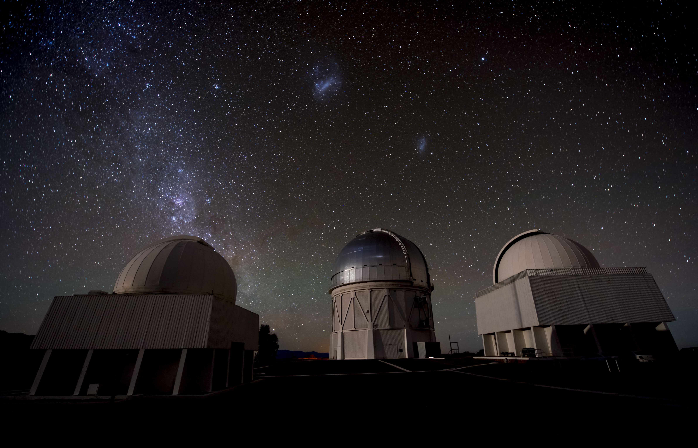
The Dark Energy Survey
Josh Frieman
Fermilab and the University of Chicago
Dark Energy Survey Director
XIX Xmas Workshop, IFT
Madrid, December 12, 2013

Slide 2
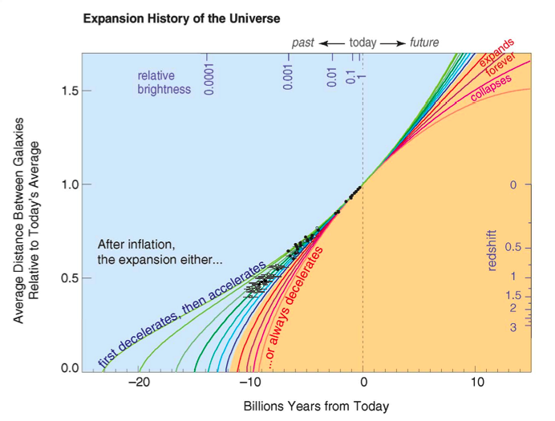
Supernova Data (1998)

Slide 3
Cosmological Dynamics
Friedmann
Equation from
GR
Notes:
In our Newtonian derivation of cosmology, we implicitly assumed that the energy content of the Universe was dominated by the rest-mass of the particles, i.e., that the particles are slowly moving: non-relativistic. In Einstein’s General Relativity, stress-energy, e.g., pressure, gravitates, and it becomes significant in the relativistic regime. In order to drive accelerated expansion, there must be a component with negative pressure comparable to the energy density: this is the defining feature of Dark Energy.

Slide 4
Cosmological Constant and Acceleration
Einstein:
Lemaitre:
Vacuum
Energy:

Slide 5
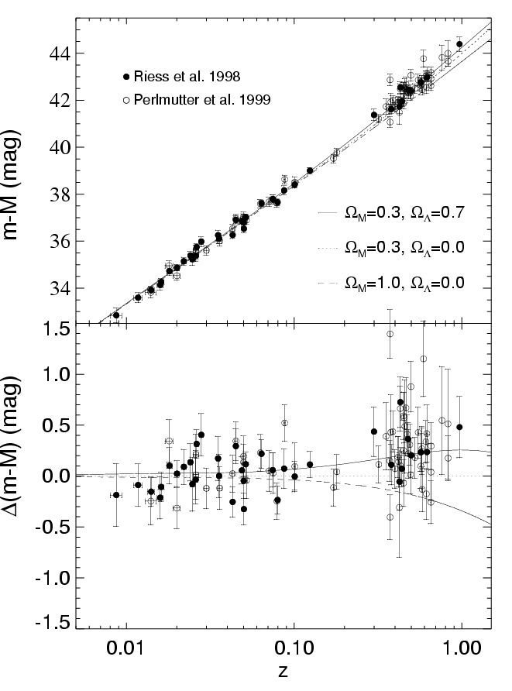
Log(distance)
Discovery of Cosmic Acceleration from
High-redshift
Supernovae
Type Ia supernovae that exploded when the Universe was 2/3 its present size are ~25% fainter than expected
Accelerating
Ω_{Λ} = 0.7
Ω_{Λ} = 0.
Ω_{m} = 1.
Not accelerating
redshift

Slide 6
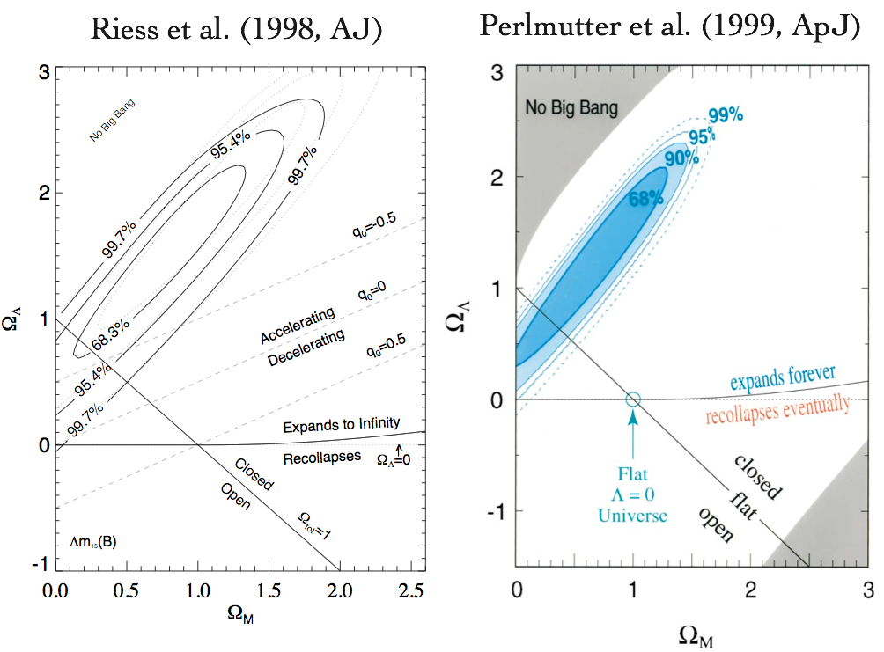
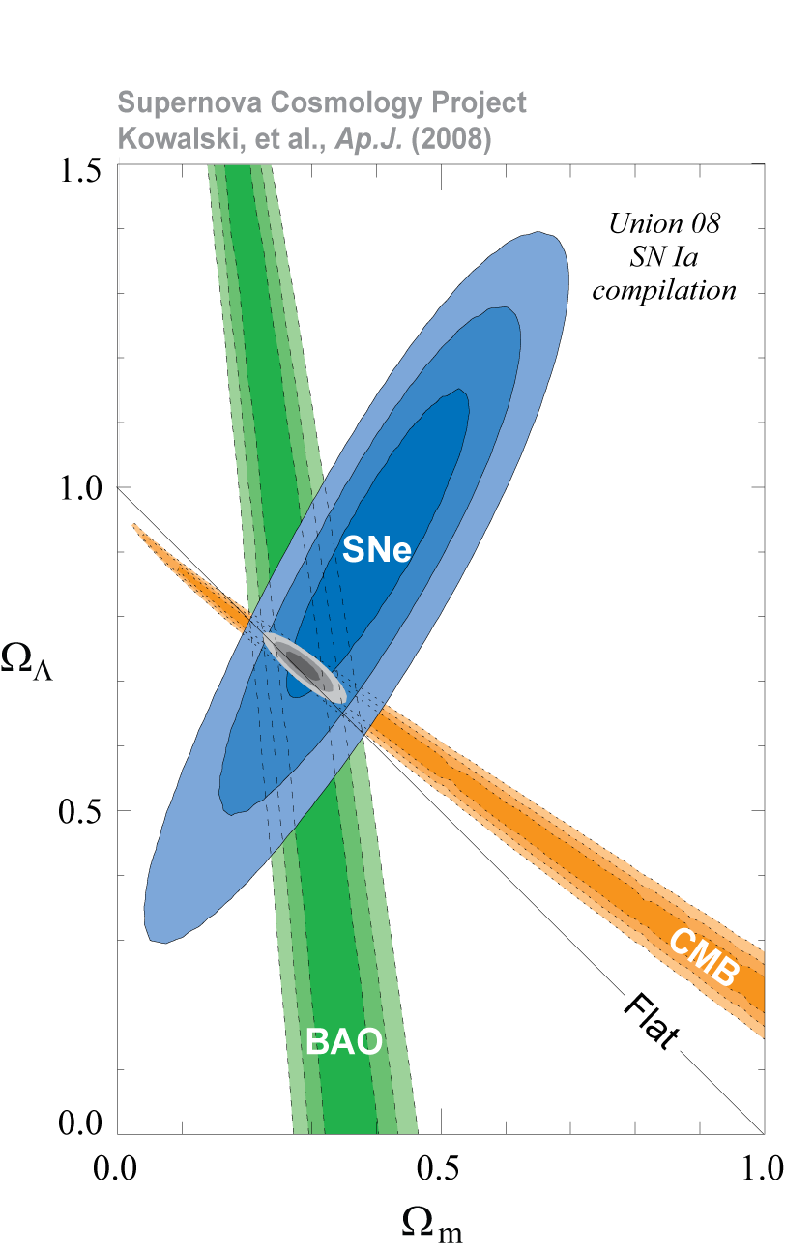

Slide 7
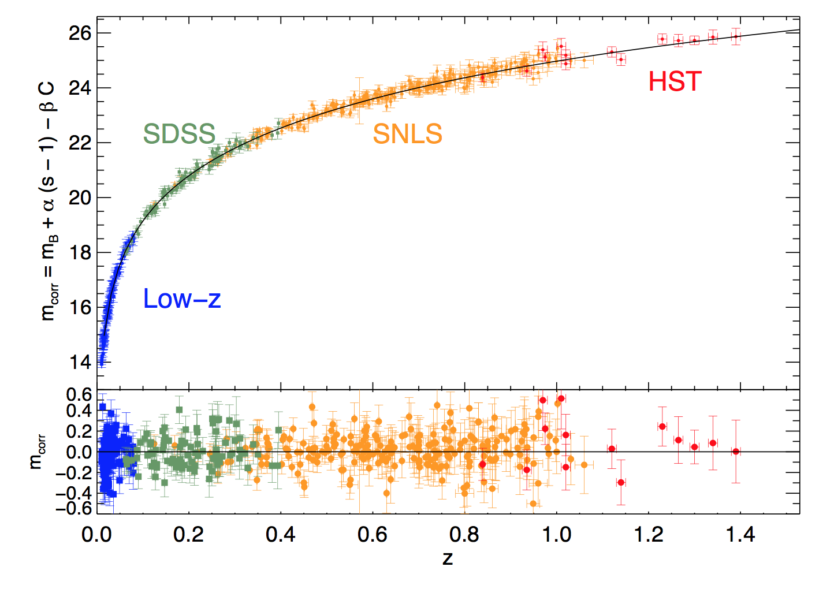
Recent SN Hubble Diagram
Sullivan etal 2011
Conley etal 2011

Slide 8
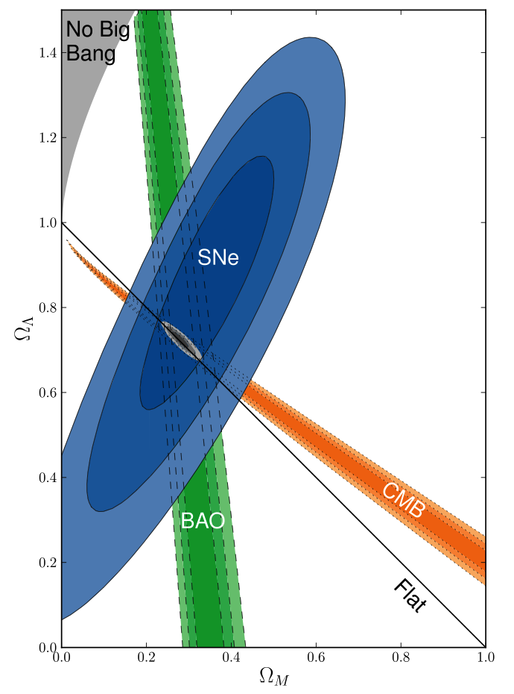
Supernovae
Baryon Acoustic Oscillations
Cosmic Microwave Background
Progress over the last 15 years

Slide 9
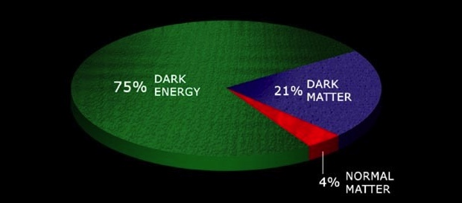
From Discovery to Physics
What is the physical cause of cosmic acceleration?
  Dark Energy or modification of General Relativity?
    If Dark Energy, is it Λ (the vacuum) or something else?
      What is the DE equation of state parameter w and (how) does it evolve?
70%
25%

Slide 10
Theory?
No consensus model for Dark Energy or Modified Gravity
Theoretical prejudice in favor of cosmological constant (vacuum energy) with w=−1 was probably wrong once (Cf. inflation): not a strong argument for it being correct now
Cosmological constant problem (why is vacuum energy density not 120 orders of magnitude larger?) is not necessarily informative for model-building
Some alternatives to Λ (Cf. quintessence) rely on notion that a very light degree of freedom can take ~current Hubble time to reach its ground state.

Slide 11
Scalar Field Dark Energy
(aka quintessence)
Dark Energy could be due to a very light scalar field φ, slowly evolving in a potential, V(φ):
Density & pressure:
Slow roll:
V(ϕ)
ϕ

Slide 12
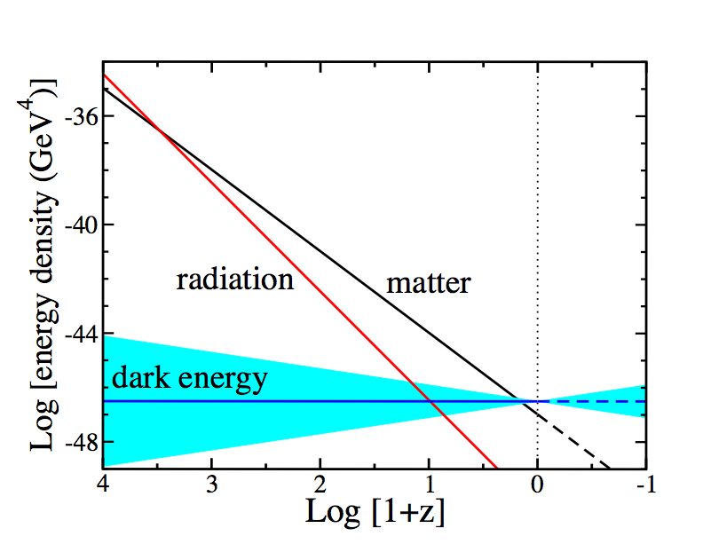
Equation of State parameter w determines Cosmic Evolution
Conservation of Energy-Momentum
=Log[a₀/a(t)]
Notes:
Energy-momentum conservation determines how the densities of different components scale with time. Before a few hundred thousand years after the BB, radiation or relativistic particles dominated, followed by non-relativistic matter, followed at ~8 Gyr by dark energy. In order for dark energy to cause cosmic speed-up, its equation of state must be such that its energy density scales slowly compared to matter and radiation. Thus, we expect dark energy to be important only at recent cosmic epochs.

Slide 13
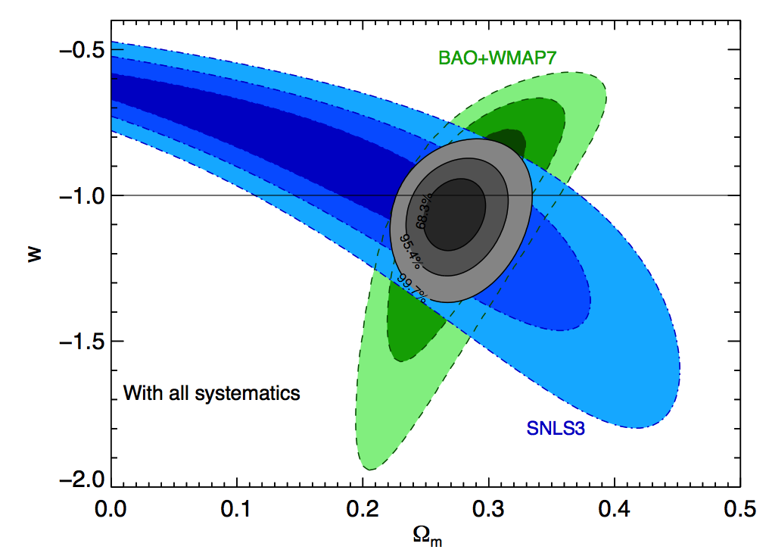
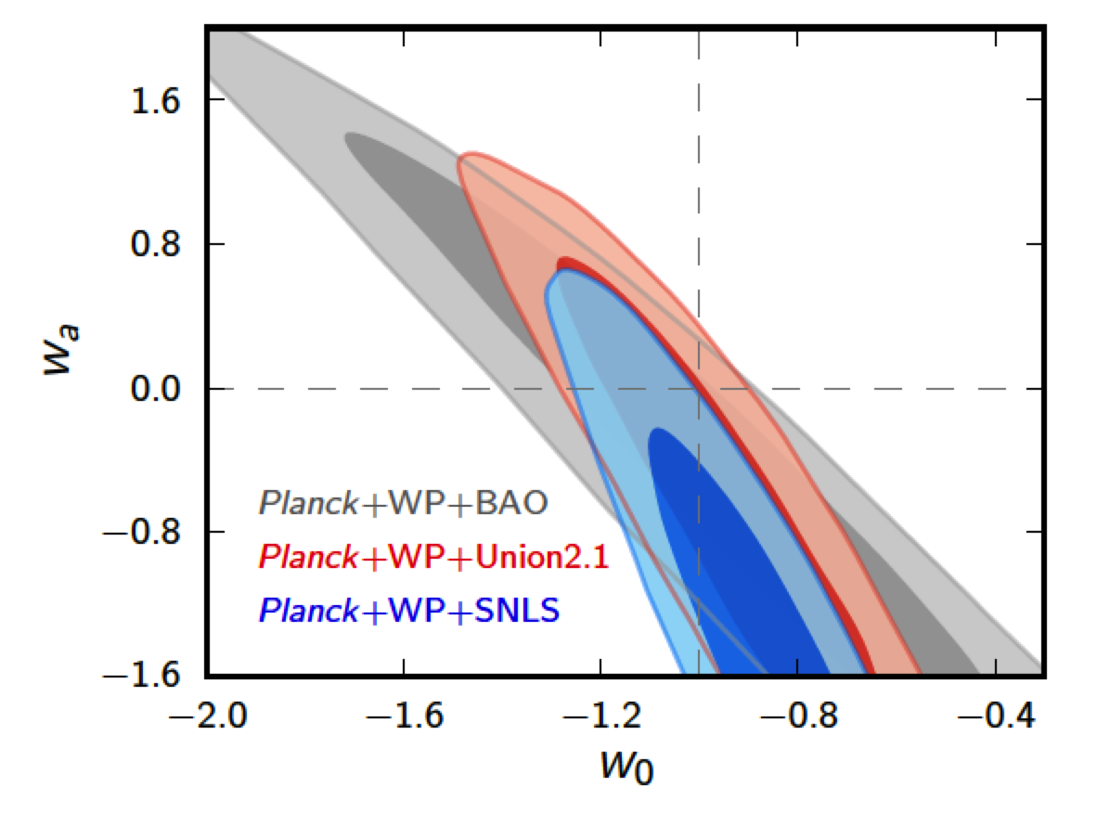
Recent Constraints from Supernovae, CMB, and Large-scale Structure
Assuming constant w Assuming w=w₀+w_{a}(1-a)
~7% constraint on constant w
Sullivan etal 2011
Ade etal 2013

Slide 14
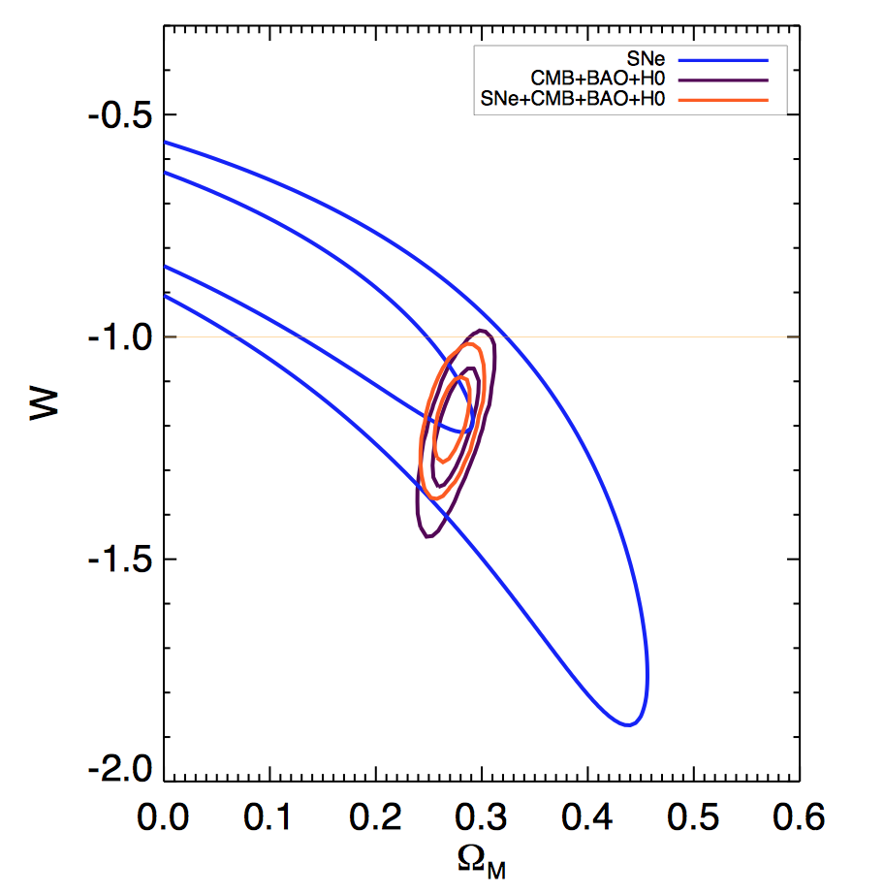
Recent Constraints from Supernovae, CMB, and Large-scale Structure
Assuming constant w Assuming w=w₀+w_{a}(1-a)
2.4σ tension
with constant
w=-1
~7% constraint on constant w
Rest, Scolnic, etal
PanSTARRS
Sullivan etal 2011
SDSS+SNLS joint analysis due out soon

Slide 15
What can we probe?
Require both to disentangle Dark Energy from Modified Gravity
Probe dark energy through the history of the expansion rate:
and the growth of large-scale structure:
Weak Lensing cosmic shear Distances+growth
Supernovae Distances
Baryon Acoustic Oscillations Distances and H(z)
Cluster counts Distances+growth
Redshift Distortions Growth
Growth of
Density
Perturbations
Distance, expansion rate vs.
redshift

Slide 16
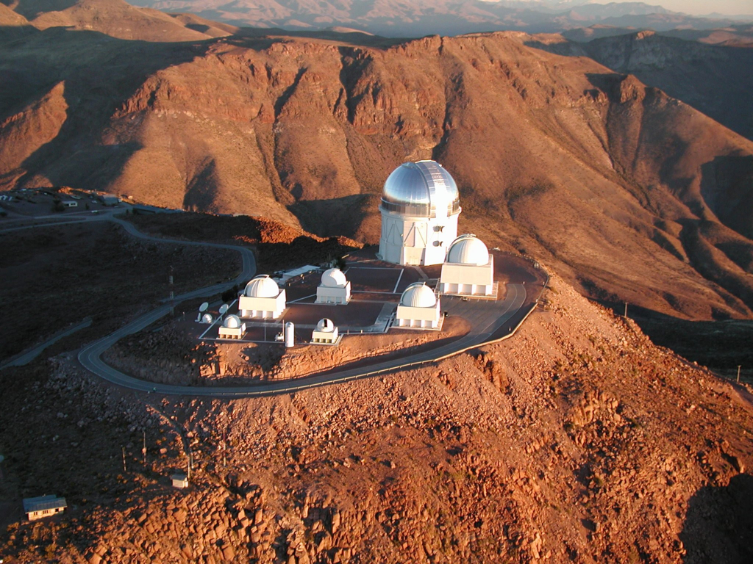
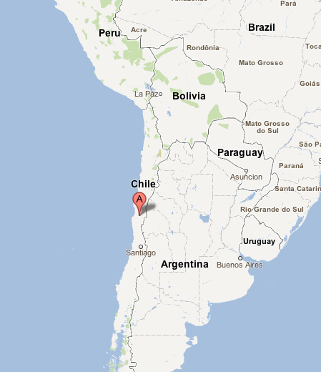
Cerro Tololo Inter-American Observatory
Blanco Telescope
Excellent astronomical site in Chilean Andes:
  good seeing: ~0.75” median for site
  high, dry: high percentage of clear, photometric nights
Late 2003: NOAO Announcement of Opportunity for new facility instrument on the Blanco 4-meter telescope
DES collaboration formed to build Dark Energy Camera and carry out Dark Energy Survey
16

Slide 17
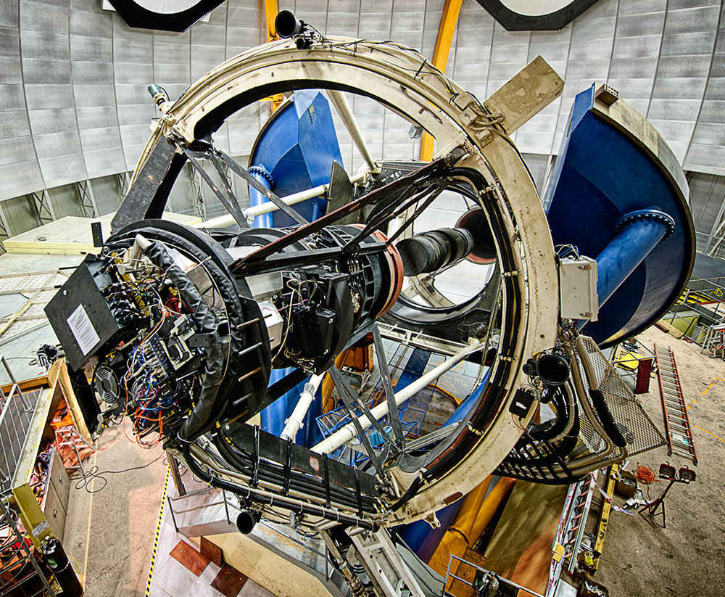
The Dark Energy Survey
DECam on the Blanco
Probe Dark Energy and the origin of Cosmic Acceleration:
  History of cosmic expansion
  Growth of structure
• Two multicolor surveys:
300 M galaxies over 1/8 sky
4000 supernovae (30 sq deg)
Using new camera on the Blanco
• Five-year Survey started Aug. 31, 2013
525 nights (Sept.-Feb.)
www.darkenergysurvey.org
www.darkenergydetectives.org

Slide 18
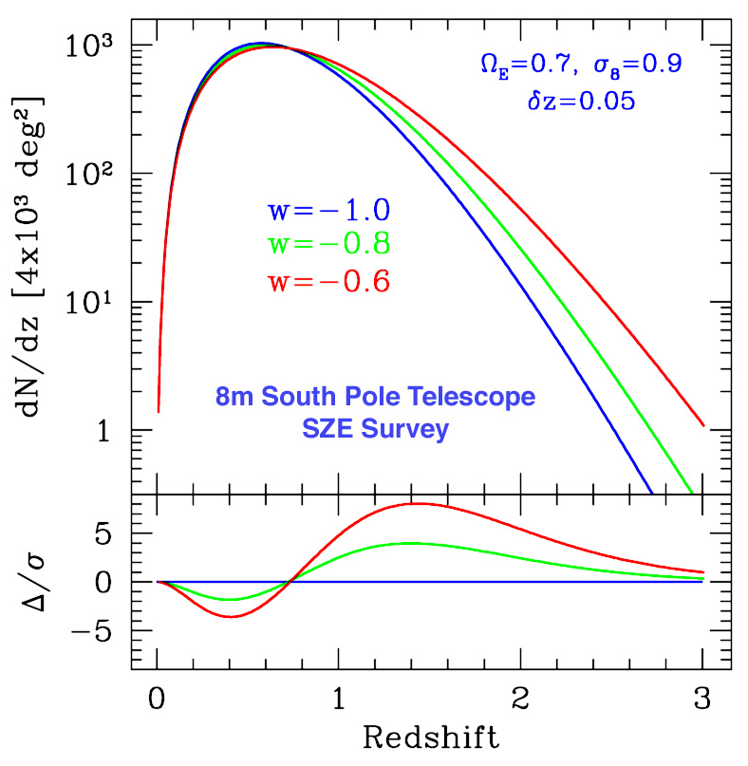
I. Clusters
  Clusters are proxies for massive halos and can be identified to redshifts z>1
  Galaxy colors provide photometric redshift estimates for each cluster, σ(z)~0.01
  Challenge: determine mass-observable relation p(O|M,z) with sufficient precision
  Multiple observable proxies O for cluster mass: optical richness (DES), SZ flux (SPT), weak lensing mass (DES), X-ray flux
Number of clusters above mass threshold
Dark Energy
equation of state
Mohr
Volume Growth

Slide 19
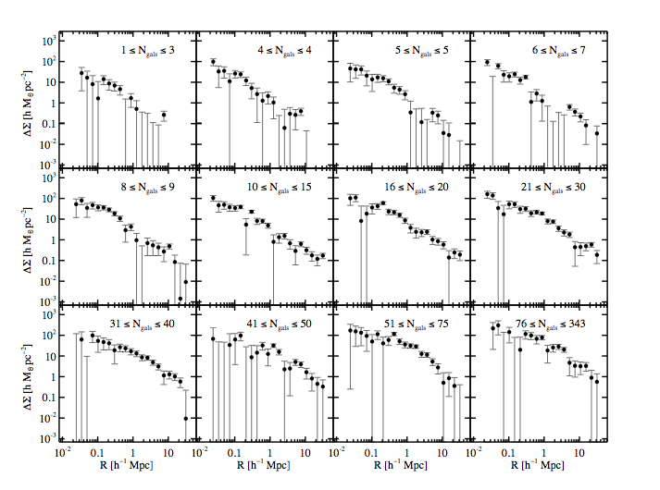
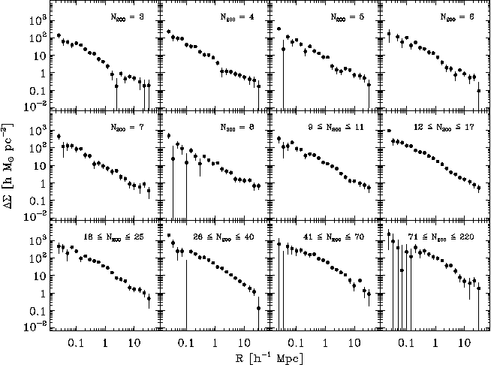
Statistical Weak Lensing by Galaxy Clusters
Mean Tangential Shear Profile in Optical Richness (N_{gal}) Bins to
30 h⁻¹Mpc
Sheldon,
Johnston, etal
SDSS

Slide 20
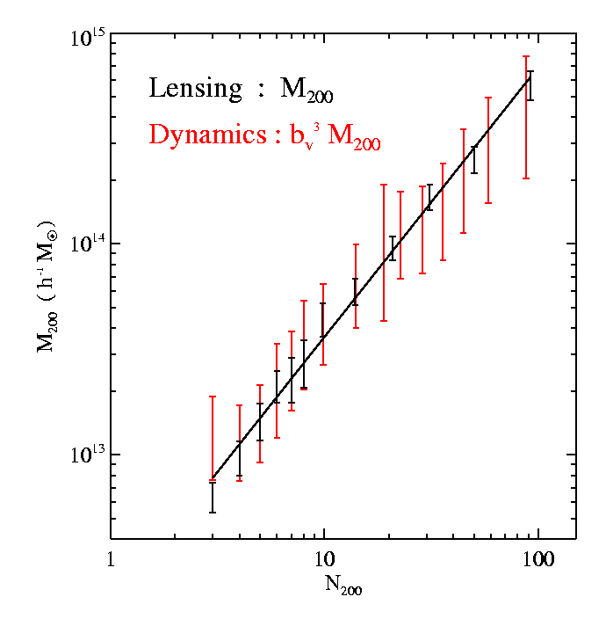
Statistical Weak Lensing Calibrates
Cluster Mass vs. Observable Relation
Cluster Mass
vs. Number
of galaxies they contain (richness)
from SDSS
Johnston,
Sheldon, etal

Slide 21
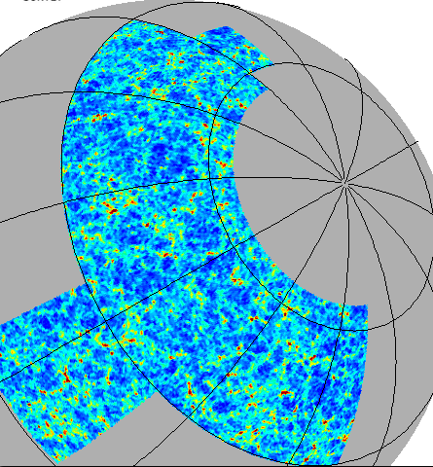
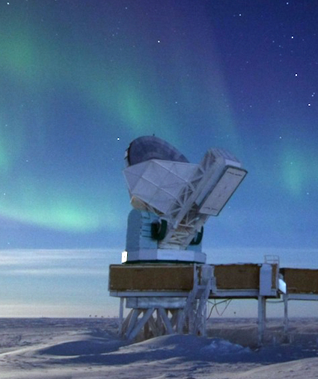
Synergy with South Pole Telescope
DES footprint: 5000 sq deg
DES survey area encompasses SPT Sunyaev-Zel’dovich Cluster Survey

Slide 22
Synergy with South Pole Telescope
DES footprint: 5000 sq deg
SPT survey
Area:
2500
sq deg
DES survey area encompasses SPT Sunyaev-Zel’dovich Cluster Survey
SZ flux correlates with cluster halo mass with ~10% scatter

Slide 23
II. Weak Lensing: Cosmic Shear
Background
sources
Dark matter halos
Observer
Spatially coherent shear pattern, ~1% distortion
Radial distances depend on expansion history of Universe
Foreground mass distribution depends on growth of structure

Slide 24
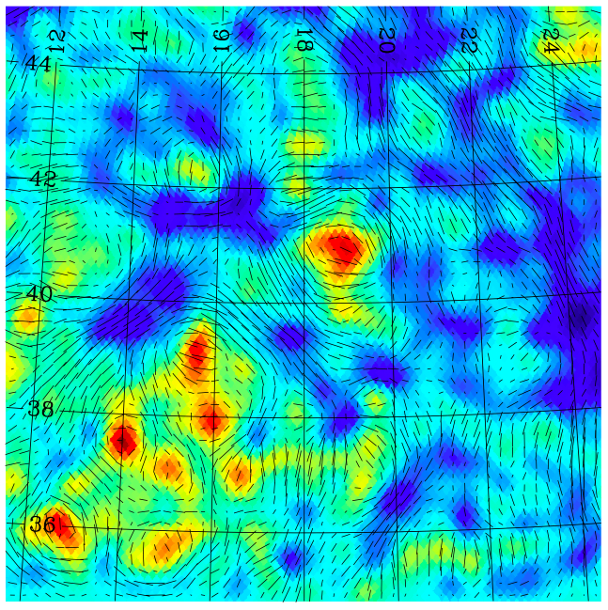
Weak Lensing Mass and Shear
DES Simulation
Tick marks: shear
Colors: projected
mass density
Becker, Kravtsov, etal

Slide 25
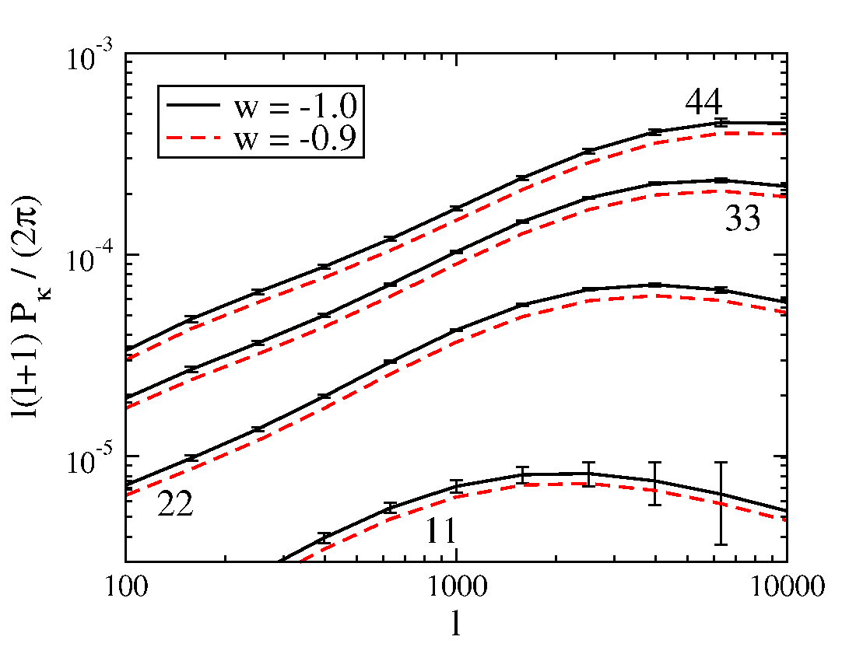
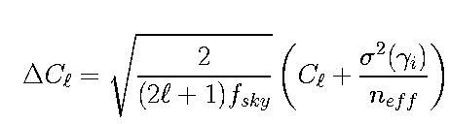

Weak Lensing Tomography
Huterer etal
Cosmic Shear Angular Power Spectrum in 4
Photo-z Slices
Shapes of ~200 million well-resolved galaxies,
⟨z⟩ = 0.7
Systematics Challenges:
photo-z’s, intrinsic alignments, PSF anisotropy, shear calibration, nonlinear+baryon P(k) effects
Statistical errors
shown
Non-linear regime
25

Slide 26
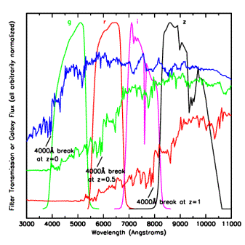
Photometric Redshifts
• Measure relative flux in multiple
filters (colors)
• Fit colors to template spectra or
use spectroscopic data to train
empirical z=f(colors) relation.
• Estimate galaxy redshifts with
accuracy σ(z) < 0.1 (~0.01 for
clusters)
• Precision is sufficient for Dark
Energy probes, provided error
distributions well measured.
Challenge: spectroscopic data
not complete to depth of survey
Elliptical galaxy spectrum

Slide 27
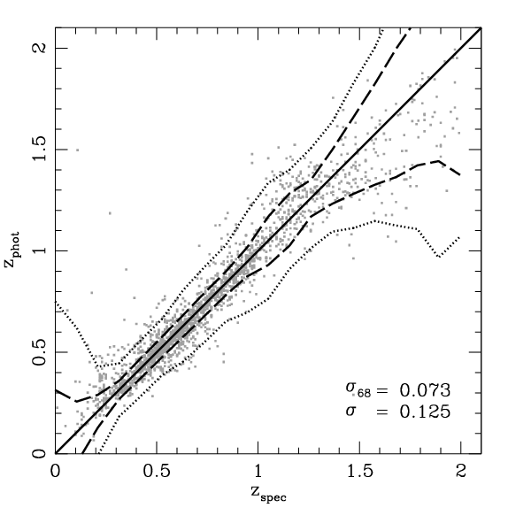
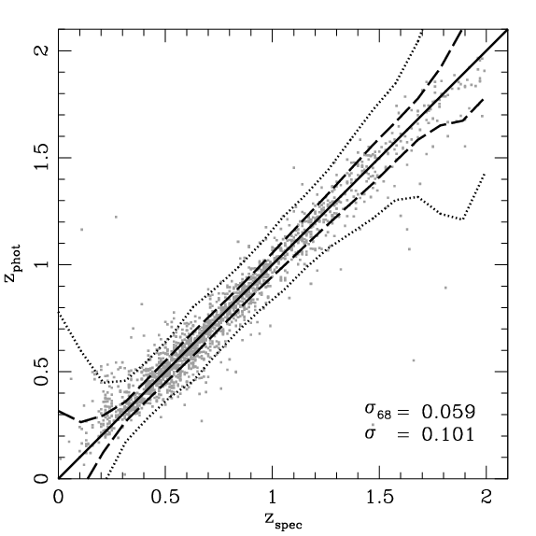
Galaxy Photo-z Simulations
+VHS*
DES
DES griz
DES griZY
+VHS JHKs on
ESO VISTA 4-m
reduces photo-z
errors for z>1
10σ Limiting Magnitudes
g 24.6
r 24.1
i 24.0
z 23.8
Y 21.6
+2% photometric calibration
error added in quadrature
J 20.3
H 19.4
Ks 18.3
*Vista Hemisphere Survey
(ESO Public Survey)

Slide 28
III. Large-scale Structure
MICE N-body simulation from DES Barcelona group

Slide 29
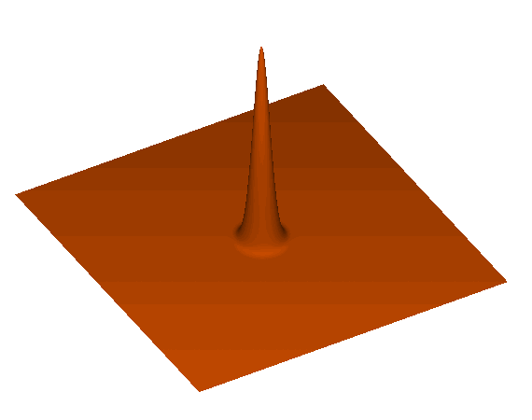
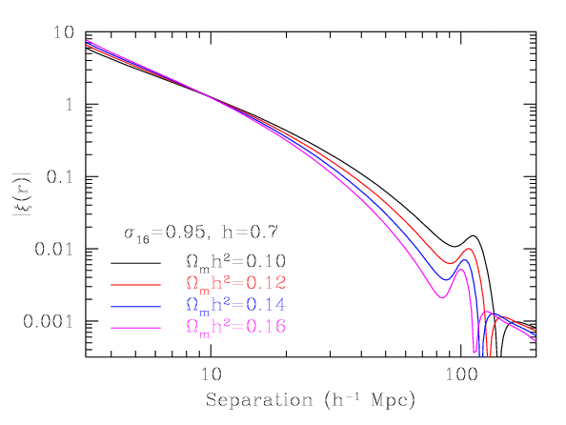
Baryon Acoustic Oscillations
Each initial overdensity (in dark matter & gas) is an overpressure that launches a spherical sound wave.
This wave travels outwards at 57% of the speed of light.
Pressure-providing photons decouple at recombination. CMB travels to us from these spheres.
Sound speed plummets. Wave stalls at a radius of 150 Mpc.
Overdensity in shell (gas) and in the original center (DM) both seed the formation of galaxies. Preferred separation of 150 Mpc.
Galaxy correlation
function
Eisenstein

Slide 30
Galaxy
CMB
Slide from
E. Gaztanaga,
DES Spain

Slide 31
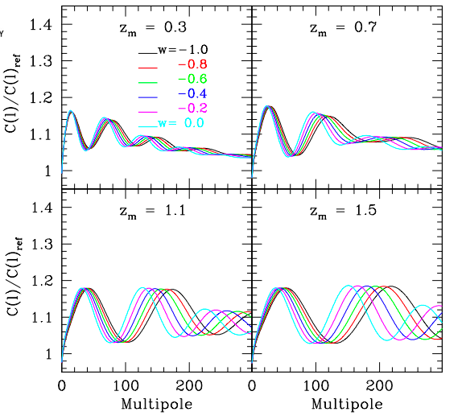
Baryon Acoustic Oscillations
Galaxy angular
power spectrum
in photo-z bins (relative to model without BAO)
Photometric surveys provide this angular measure
Fosalba & Gaztanaga

Slide 32
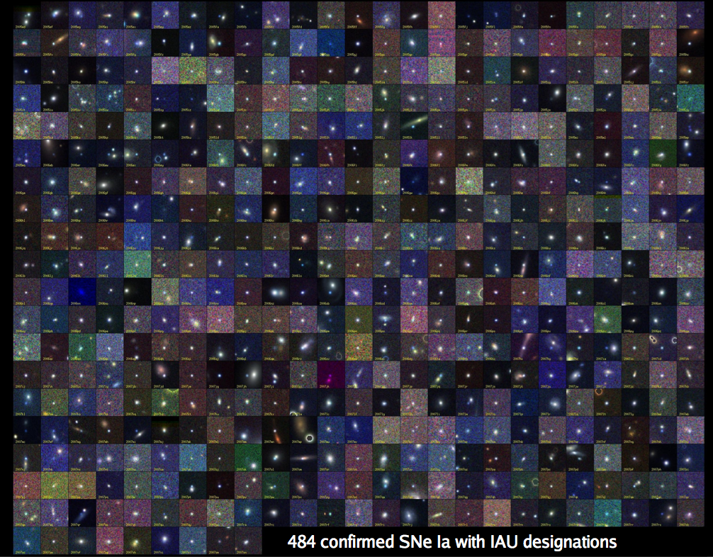
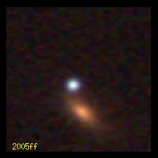
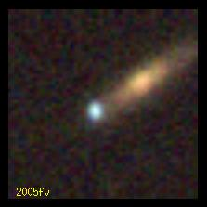
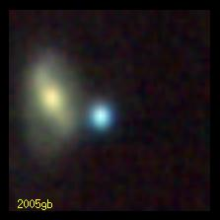
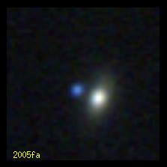
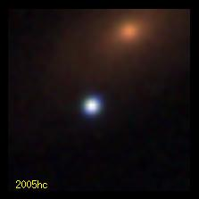
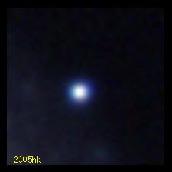
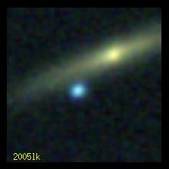
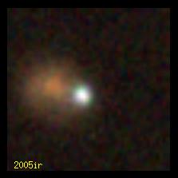
IV. Supernovae
B. Dilday
SDSS-II: 500 spectroscopically confirmed SNe Ia, >1000 with host redshifts from SDSS-III

Slide 33
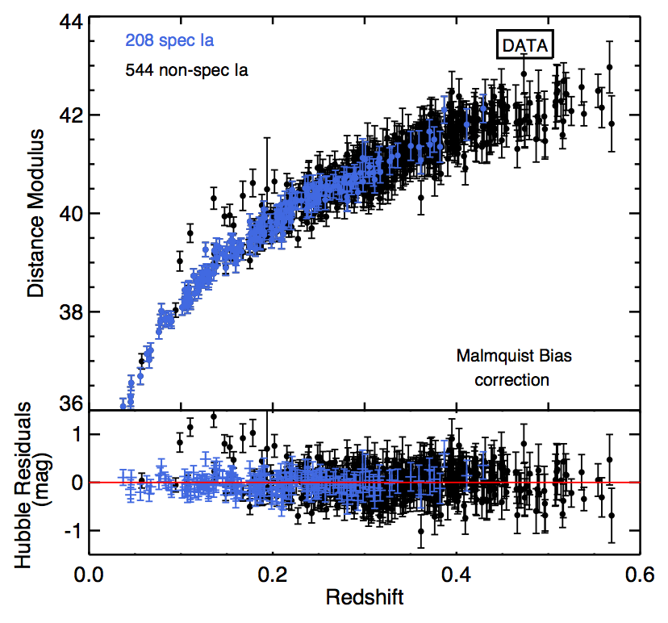
Photometric SN Cosmology
Hubble diagram of SDSS SNe Ia: spectroscopic plus those classified photometrically that have host-galaxy redshifts
DES will have host redshifts, plus SN spectra for a subsample
SDSS Results
Campbell, etal

Slide 34
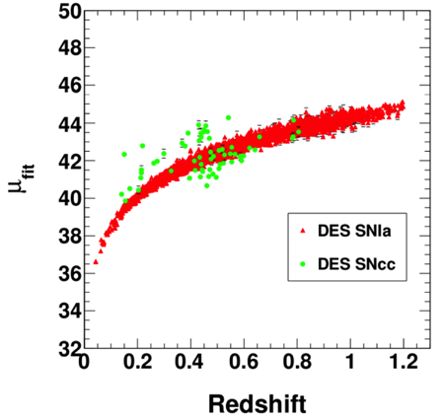
Photometric SN Cosmology
Hubble diagram of SDSS SNe Ia: spectroscopic plus those classified photometrically that have host-galaxy redshifts
DES will have host redshifts, plus SN spectra for a subsample
DES Simulations
Core-Collapse SNe
(contaminants)
SNe Ia
Distance modulus (log distance)
SDSS Results
Bernstein, etal

Slide 35
DES Science Summary
Current Constraints on DE
Equation of State
Four Probes of Dark Energy
Galaxy Clusters
  ~100,000 clusters to z>1
  Synergy with SPT, VHS
Weak Lensing
  Shape and magnification measurements of 200 million galaxies
Baryon Acoustic Oscillations
  300 million galaxies to z = 1 and beyond
Supernovae
  30 sq deg time-domain survey
  ~4000 well-sampled SNe Ia to z ~1
Ade, etal

Slide 36
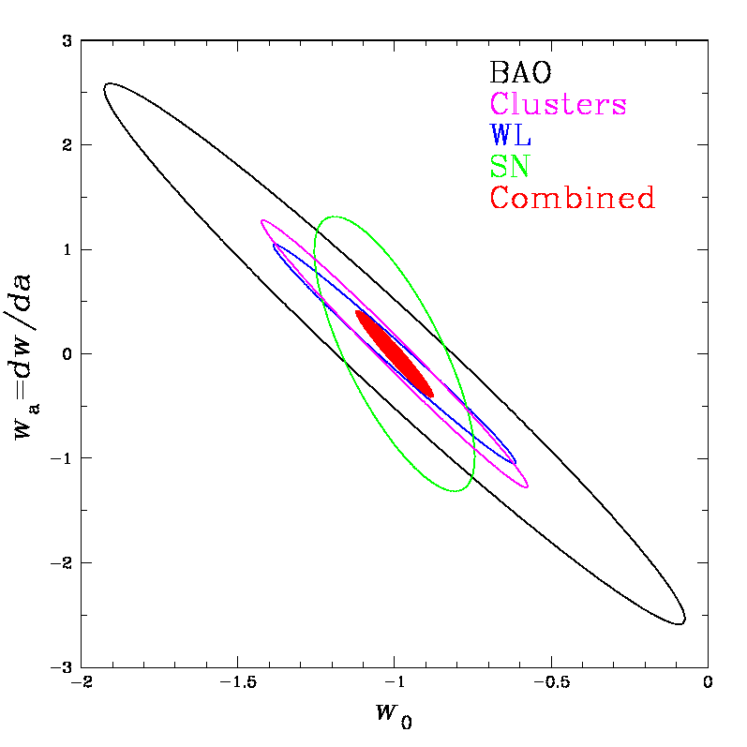
DES Science Summary
Forecast Constraints on DE
Equation of State
Four Probes of Dark Energy
Galaxy Clusters
  ~100,000 clusters to z>1
  Synergy with SPT, VHS
Weak Lensing
  Shape and magnification measurements of 200 million galaxies
Baryon Acoustic Oscillations
  300 million galaxies to z = 1 and beyond
Supernovae
  30 sq deg time-domain survey
  ~4000 well-sampled SNe Ia to z ~1
DES forecast

Slide 37
DES Science Summary
Current Constraints on DE
Equation of State
Four Probes of Dark Energy
Galaxy Clusters
  ~100,000 clusters to z>1
  Synergy with SPT, VHS
Weak Lensing
  Shape and magnification measurements of 200 million galaxies
Baryon Acoustic Oscillations
  300 million galaxies to z = 1 and beyond
Supernovae
  30 sq deg time-domain survey
  ~4000 well-sampled SNe Ia to z ~1
DES forecast

Slide 38
















Dark Energy Survey Collaboration
~300 scientists from around
the world
Fermilab, UIUC/NCSA, University of Chicago,
LBNL, NOAO, University of Michigan, University of Pennsylvania, Argonne National Lab, Ohio State University, Santa-Cruz/SLAC/Stanford, Texas A&M
UK Consortium:
UCL, Cambridge, Edinburgh, Nottingham, Portsmouth, Sussex
ETH Zurich
LMU
Ludwig-Maximilians Universität
Spain Consortium:
CIEMAT, IEEC, IFAE
Brazil Consortium
CTIO

Slide 39
DES Group in Madrid
Eusebio Sanchez
Juan Garcia-Bellido
Ignacio Sevilla
Juan de Vicente
Savvas Nesseris
Rafael Ponce
Javier Sanchez
Ana Salvador
Santiago Avila
CIEMAT and UAM
DES contributions from Spanish Ministry of Science and Education

Slide 40
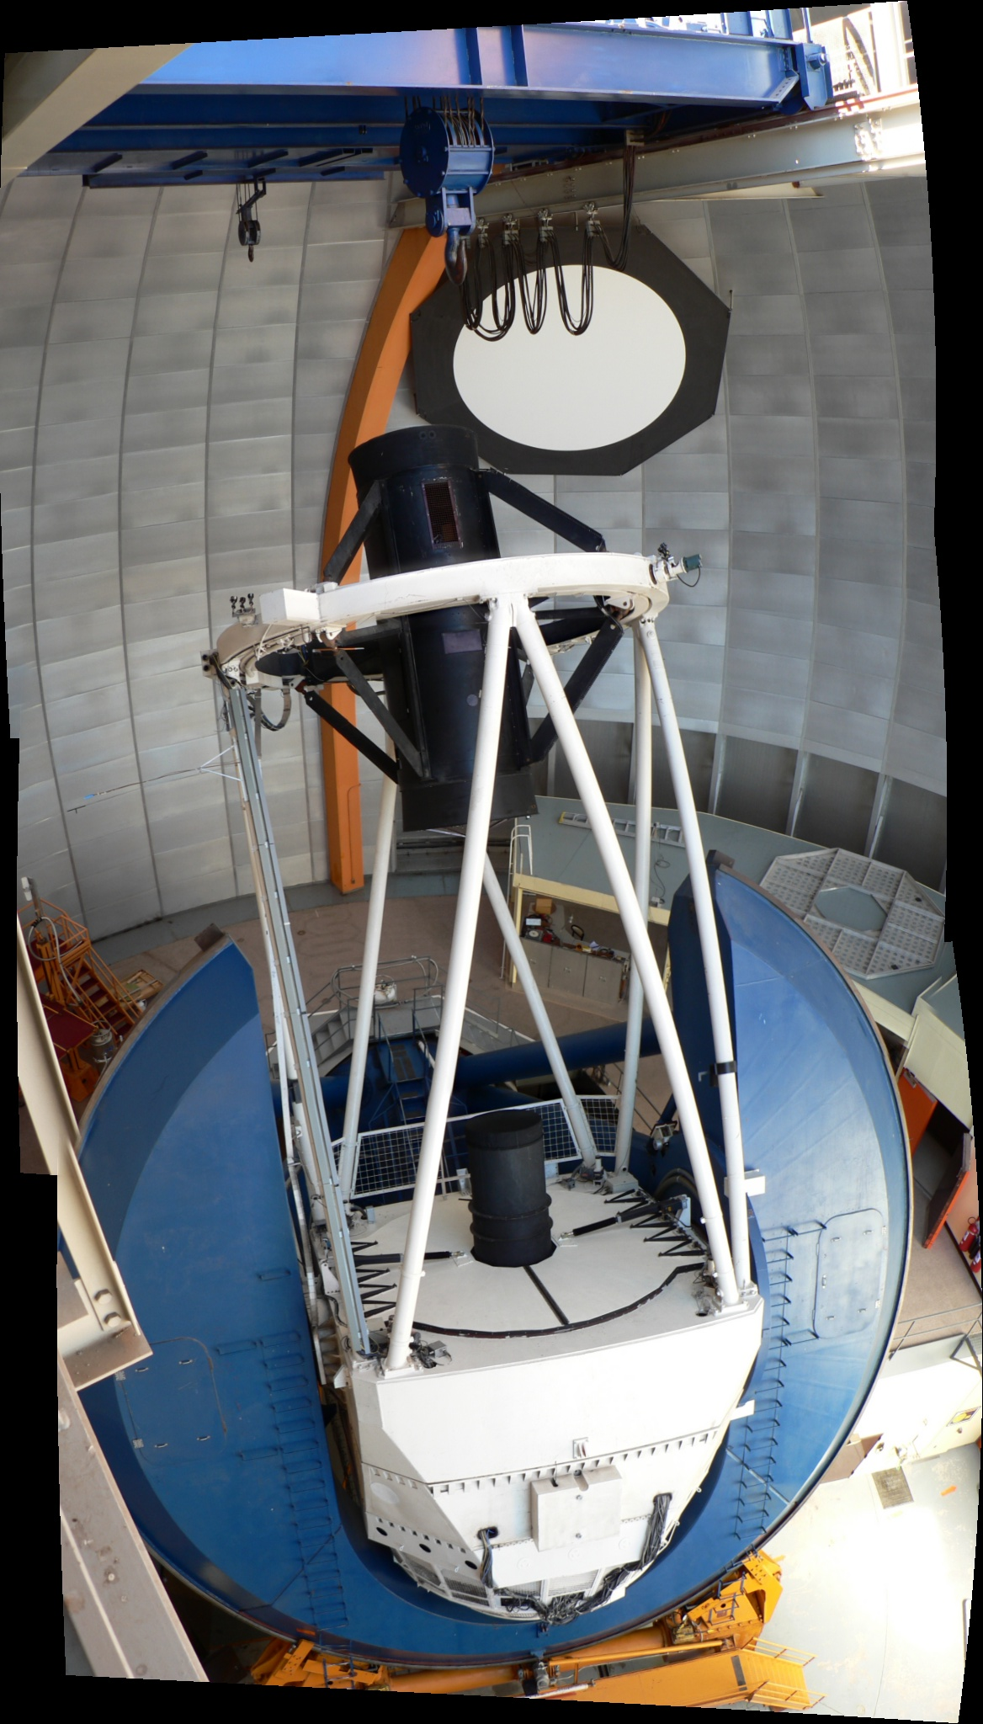
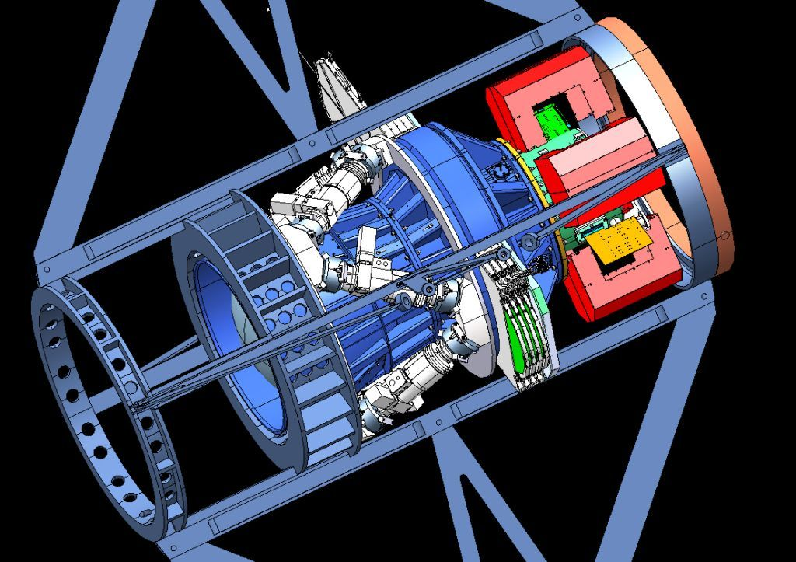
Dark Energy Camera
Mechanical Interface of DECam Project to the Blanco
CCD
Readout
Optical
Corrector
Lenses
Hexapod: optical alignment
Filters &
Shutter

Slide 41
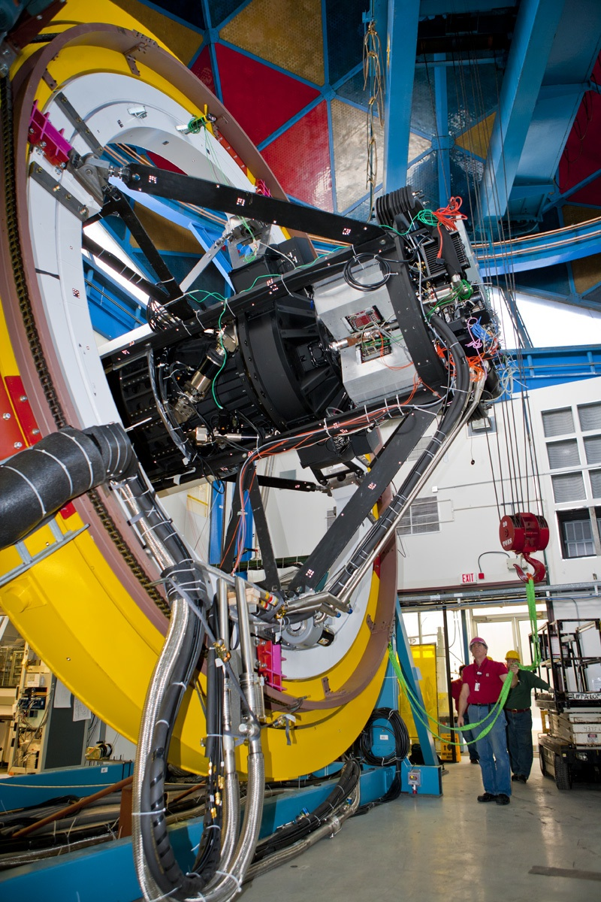
Dark Energy Camera
Mechanical Interface of DECam Project to the Blanco
CCD
Readout
Optical
Corrector
Lenses
Hexapod: optical alignment
Filters &
Shutter
DECam mounted on
Telescope Simulator
at Fermilab in early 2011

Slide 42
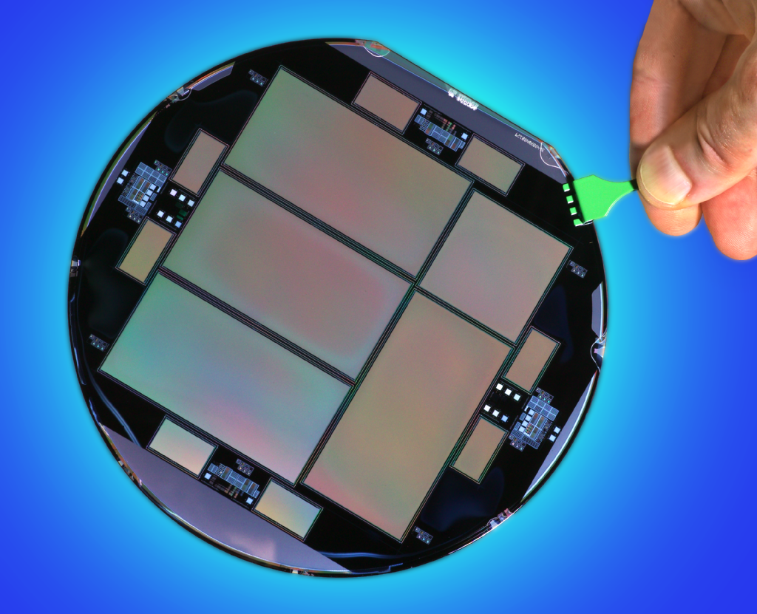
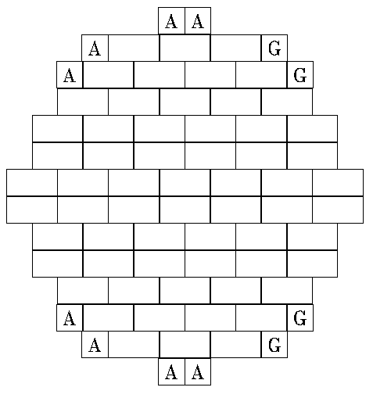
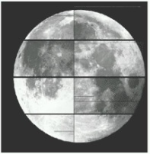
DECam CCDs
62 2kx4k fully depleted CCDs: 520 Megapixels, 250 micron thick, 15 micron (0.264”) pixel size
12 2kx2k guide and focus chips
Excellent red sensitivity
Developed by LBNL, packaged and tested at FNAL
Total 570 Megapixels
2.2 deg

Slide 43
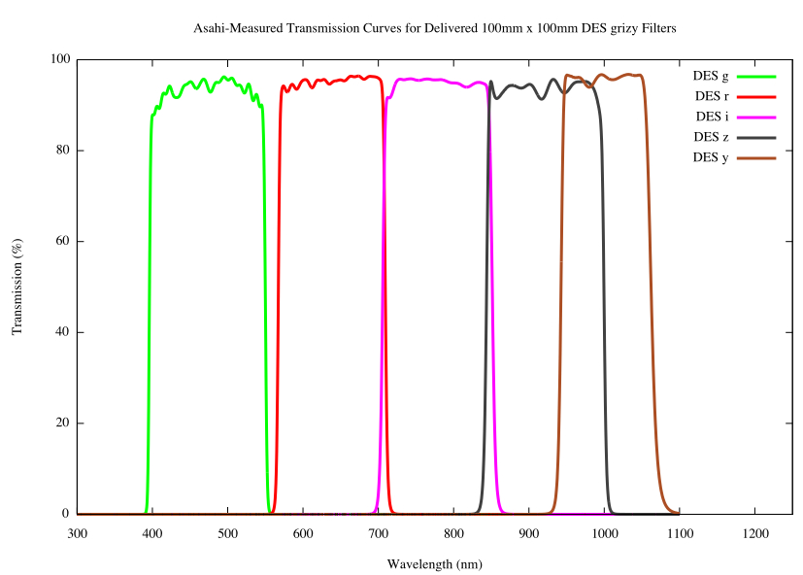
DECam CCDs
62 2kx4k fully depleted CCDs: 520 Megapixels, 250 micron thick, 15 micron (0.264”) pixel size
12 2kx2k guide and focus chips
Excellent red sensitivity
Developed by LBNL, packaged and tested at FNAL
Total 570 Megapixels
g r i z Y
DES filters
2.2 deg

Slide 44
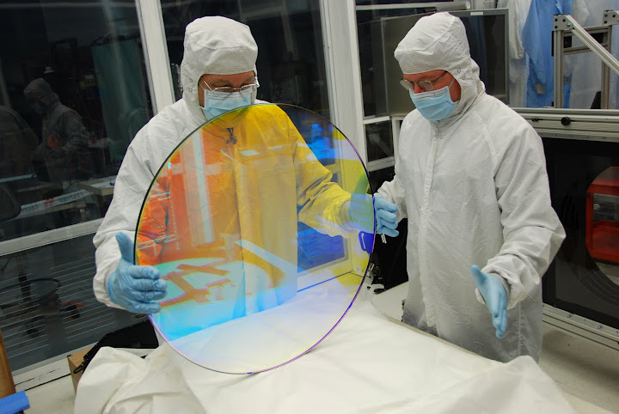


Filters
600 mm clear aperture, tight uniformity constraints, excellent throughput.
Fabrication completed by Asahi within months of the tsunami in Japan.
C4
Filters &
Shutter
r-filter
i-filter

Slide 45

570-Million pixel
Dark Energy Camera

Slide 46


Optical Corrector Lenses
Field of view: 2.2º diameter
Good image quality across FOV
Optical elements aligned at UCL
Focal plane
C4
Filters &
Shutter
S. Kent (Fermilab)

Slide 47



Biggest Lens
(out of 5 lenses)

Slide 48


Slide 49


Slide 50


Slide 51


Slide 52

New Cage Installed early May
DECam Prime Focus Cage Installed
early May 2012

Slide 53


Imager Installation
August
2012

Slide 54
Imager Installation
August
2012

Slide 55

Dark Energy Camera on the Blanco Telescope

Slide 56

First Images
Fornax Cluster
of Galaxies
First Light on Sept. 12, 2012
covered in 258 publications in 35 countries

Slide 57

First Images
NGC 1365
Galaxy NGC 1365 in Fornax image from a single CCD

Slide 58

Early Image taken with the Dark Energy Camera

Slide 59

Orion nebula

Slide 60

DES Observing Strategy
10x90 sec exposures in griz, 10x45 sec in Y for wide-area survey, longer exposures in SN fields
Bluer (redder) bands in bright (dark) time (the moon is blue)
Multiple overlapping exposures for photometric calibration
2 exposures/filter/year over entire survey footprint, except in first 2 years
Do supernova fields when seeing is worse or when they haven’t been recently observed
DES Footprint: (grey)
Galactic
extinction
Stellar
density
Total area: 5000 sq. deg
10 Supernova fields (2 deep, 8 shallow), distributed within wide-area footprint
Footprint is overhead at night from Sept.-Feb.

Slide 61

Science Verification Observations
Nov. 2012-Feb. 2013

Slide 62

DES SV 1x1deg
grizY co-add image of SPT
cluster
z=0.32
~50,000 galaxies in this image

Slide 63


Slide 64

Another Cluster of Galaxies

Slide 65

High Redshift Cluster Discovered by DES
from DES Science Verification data in November 2012

Slide 66

Cluster Weak Lensing:
`Seeing’ Dark Matter
Image: light from a cluster of galaxies
Contours: inferred dark matter distribution in the cluster from gravitational lensing
DES SV data

Slide 67


DES SV image of a deep SN field

Slide 68
Discovering Supernovae
Nov. 7, 2012 Dec. 15, 2012
SN Ia at z=0.2 confirmed at AAO (OzDES: 100 spectroscopy nights over next 3 years)

Slide 69


Slide 70


Slide 71


DES High-redshift SN candidate

Slide 72

Strong Gravitational Lensing foreground mass bends light from distant galaxies (SV images)

Slide 73



Strong Lens Time Delays:
new/old probe of Dark Energy
Strong Lens Candidates in DES SV
Snowmass White Paper (Treu, etal).

Slide 74



DES started
Aug. 31, 2013
74

Slide 75

DES has started!
Science analysis of DES Science Verification data
underway, first results expected in coming months
First Dark Energy results expected from first 2
seasons of data
Planned public releases of processed data from 1st 2
seasons and from full survey

Slide 76


Slide 77


Slide 78


